Slide 1
**** ERLANG/OTP [64-bit] [smp:4:4] ****
16G RAM SYSTEM 14891M ELIXIR BYTES FREE READY.
▊

Slide 2
**** ERLANG/OTP [64-bit] [smp:4:4] ****
16G RAM SYSTEM 14891M ELIXIR BYTES FREE READY.
# FUNCTIONALCONF 2017
▊

Slide 3
**** ERLANG/OTP [64-bit] [smp:4:4] ****
16G RAM SYSTEM 14891M ELIXIR BYTES FREE READY.
# FUNCTIONALCONF 2017 # TWITTER @BRYAN_HUNTER
▊

Slide 4
**** ERLANG/OTP [64-bit] [smp:4:4] ****
16G RAM SYSTEM 14891M ELIXIR BYTES FREE READY.
# FUNCTIONALCONF 2017 # TWITTER @BRYAN_HUNTER
LOAD "ELIXIR BY THE BELLYFUL",8,1
▊

Slide 5
**** ERLANG/OTP [64-bit] [smp:4:4] ****
16G RAM SYSTEM 14891M ELIXIR BYTES FREE READY.
# FUNCTIONALCONF 2017 # TWITTER @BRYAN_HUNTER
LOAD "ELIXIR BY THE BELLYFUL",8,1 SEARCHING FOR ELIXIR BY THE BELLYFUL

Slide 6

**** ERLANG/OTP [64-bit] [smp:4:4] ****
16G RAM SYSTEM 14891M ELIXIR BYTES FREE READY.
# FUNCTIONALCONF 2017 # TWITTER @BRYAN_HUNTER
LOAD "ELIXIR BY THE BELLYFUL",8,1 SEARCHING FOR ELIXIR BY THE BELLYFUL LOADING
Notes:
C64 floppy sounds http://twdotnet.de/wp/2016/11/c64-floppy-sounds/
CC-BY https://creativecommons.org/licenses/by/4.0/

Slide 7
**** ERLANG/OTP [64-bit] [smp:4:4] ****
16G RAM SYSTEM 14891M ELIXIR BYTES FREE READY.
# FUNCTIONALCONF 2017 # TWITTER @BRYAN_HUNTER
LOAD "ELIXIR BY THE BELLYFUL",8,1 SEARCHING FOR ELIXIR BY THE BELLYFUL LOADING READY.
RUN
▊

Slide 8
Elixir by the Bellyful
@bryan_hunter
Notes:
Alrighty! So we have a ton of content to cover here we have a little space.
We might try to stick some demos in but but this thing is just so packed. I've worn my stretchy pants and I hope you all did too because we've got a Elixir by the bellyful..
There's me on Twitter and the hashtags. Any questions you have just throw them on Twitter
I'll get back to you as soon as I can. The code from this will be on Github … and we are off!

Slide 9

?
?
?
?
?
?
?
?
?
?
?
?
?
?
?
?
?
?
?
?
?
?
?
?
?
?
?
?
?
?
?
Notes:
so as you come to a Elixir… when you come to any language…
you bring all sorts of questions. They're all these strange things.
You look around and you say okay what do I know that I don't know
and what do I not even know that I don't know.

Slide 10
Notes:
As we look around we're looking for sea monsters; we're looking for the the pitfalls the traps the places you can get hurt
and you're also wondering about the fun that's out there that maybe you don't know about yet
So the good news is: in Elixir there's a whole lot more fun than there are sea monsters.
>>>
Public domain
https://commons.wikimedia.org/wiki/File:Measuring_azimuth_with_a_compass.pngz
https://commons.wikimedia.org/wiki/Compass_rose#/media/File:Compass_rose_browns_00.png
https://commons.wikimedia.org/wiki/File:20000_squid_holding_sailor.jpg

Slide 11
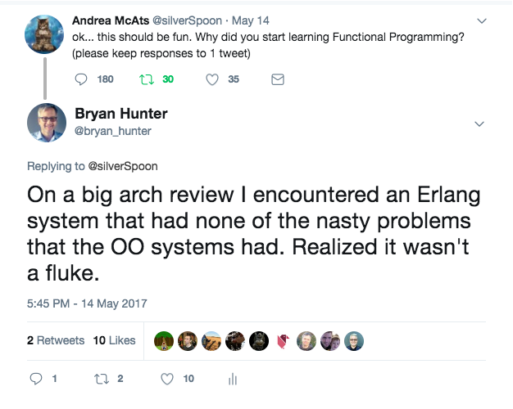
2007
2017

Slide 12
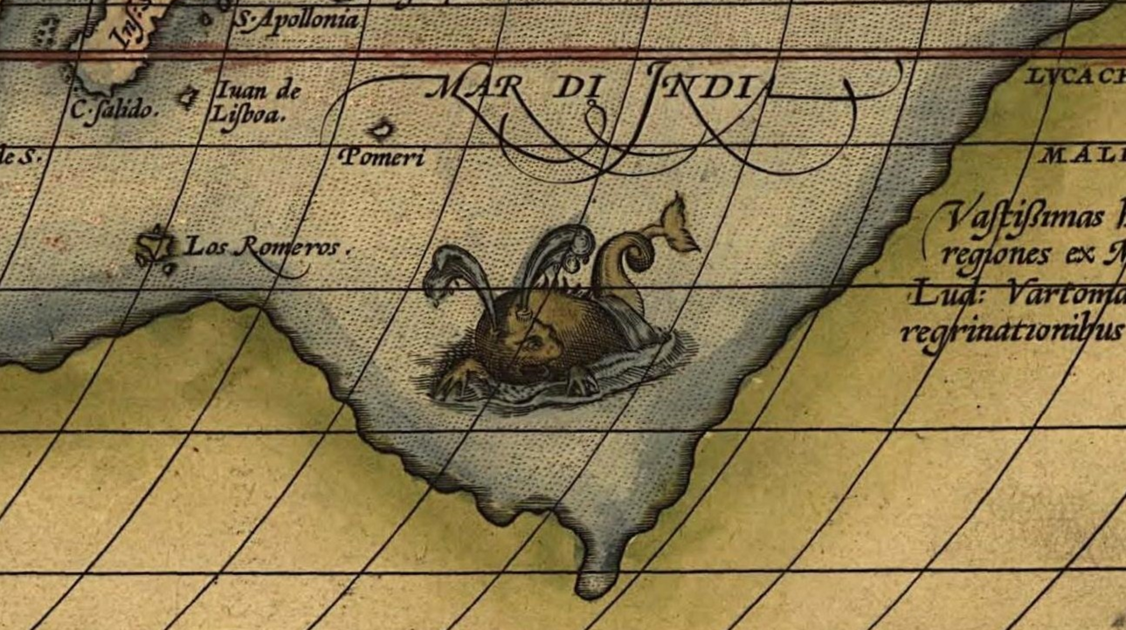
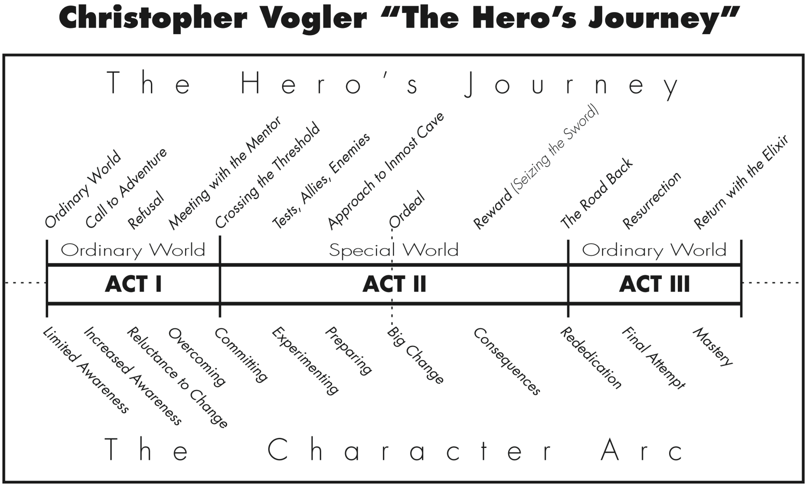

Slide 13
Erlang
OTP
FP
Elixir
ErlangVM (BEAM)
Processes
Tail recursion
&(&1)
Code loading
Ports
Immutability
Protocols
Distribution
Tools
Community
Macros
Notes:
but they're quite a few things that maybe you're not familiar with yet. We're gonna try to hit as many of these as we can in 45 minutes which is kind of insane. All of these are bits I've been asked about.
Show of hands are there some thing on here that you don't know about?
Alright, I see some hands.
[A bunch of hands? Yay! this is so awesome!]

Slide 14
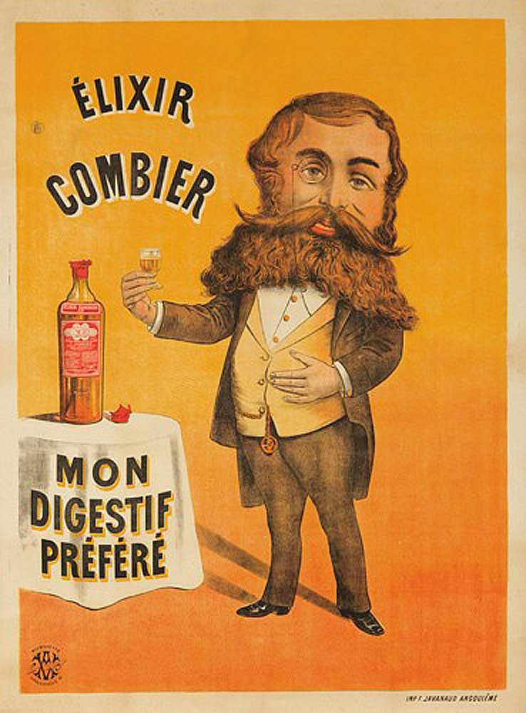
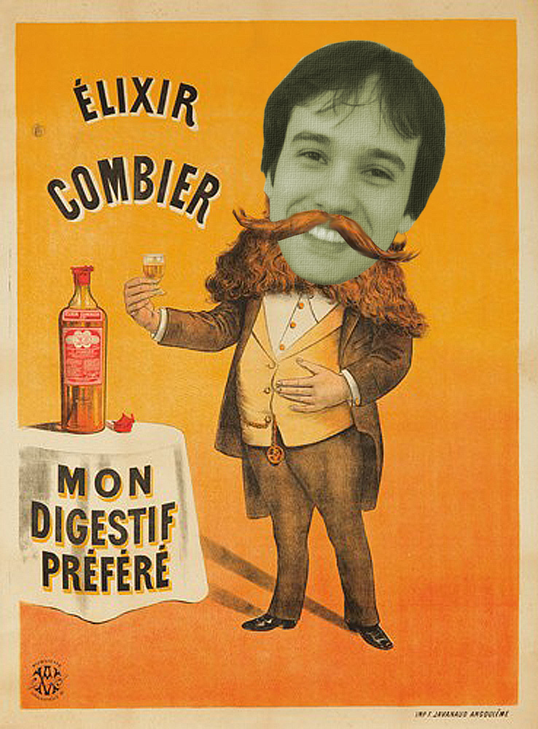

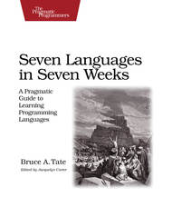

History of Elixir
2011
2014 v1.0
Notes:
Let's begin our journey with a bit of history. The beginning of Elixir. José Valim was a core member of the Ruby on Rails team and was facing these problems around concurrency, he's facing these scalability problems… of course lots of people are facing those kinds of problems on other stacks. He was an interesting position though being this core member. José… he's a curious guy and he's out there looking and he sees Bruce Tate's "seven languages in seven weeks" book and it's sort of lit him on fire because of this chapter in there on Erlang.
So it's interesting... so when he found these solutions to concurrency and scalability there on the Erlang side, why didn't he just become an Erlang developer?
You might assume Erlang's syntax was the big reason, but that wasn't it. Elixir isn't about language syntax.
Perhaps the tool chain? That is a part of it, but It goes beyond that.
Then the other question is why didn't he why didn't he just steal Erlang bits and bring back to Ruby?
We're going to find out a bit more about that, and we're going to find out why in 2011 he went on this wild crazy journey
and in the three years to v1 how he brought a community along with him rather than leaving the community
>>>
WikiMedia commons
http://commons.wikimedia.org/wiki/File:%C3%89lixir_Combier.jpg

Slide 15

Why Erlang?
Notes:
So why Erlang?

Slide 16
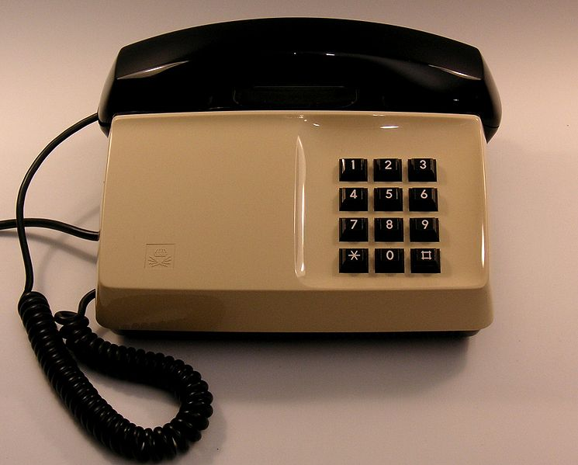
By Holger.Ellgaard (Own work) [CC BY-SA 3.0], via Wikimedia Commons
Notes:
Erlang's story begins in Stockholm at Ericsson the Swedish telecom giant. They had problems back in the 80s that that most companies didn't have then but lots of companies have now. They had to deal with lots and lots of concurrent users, and they needed to have availability. They couldn't fall down. If they fell down that was that was disaster.
>>>
Swedish standard phone "Diavox" 1976, Ericsson Diavox telephone, made for Televerket (national telecom), Sweden.
"Diavox 1975 beige" by Holger.Ellgaard - Own work. Licensed under Creative Commons Attribution-Share Alike 3.0 via Wikimedia Commons - http://commons.wikimedia.org/wiki/File:Diavox_1975_beige.jpg#mediaviewer/File:Diavox_1975_beige.jpg

Slide 17

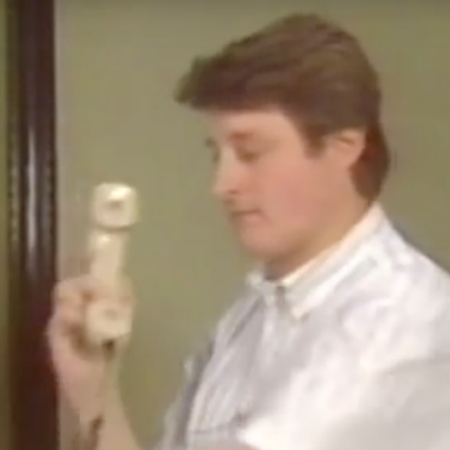
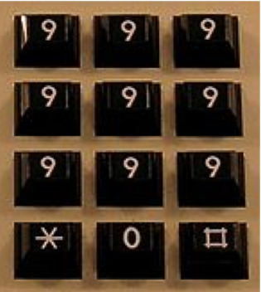


Fault-tolerant
Concurrent
Distributed
By Holger.Ellgaard (Own work) [CC BY-SA 3.0], via Wikimedia Commons
Notes:
At Ericsson so they had this lab.
Here we have Joe Armstrong here and Robert Verding and Mike Williams. They were in this lab and their job was to find and solve problems that were the problems of Telecom then. The problem again high availability so you can spend a lot of money and you can get really good equipment and that can help you on high availability but then things can actually even go wrong on good hardware. Things can go weird in the environment and things can go weird in your code you can have faults. To have high availability you have to be fault tolerant and this is the number one goal of what they were doing in their research there… this is what they were trying to solve: fault tolerance. You have a hundred thousand phone calls something goes weird. You're running your hundred thousand calls and you have some sort of crash and you crash your process and a hundred thousand phone calls die well that's terrible that's that's definitely not high availability and so that's that's a total disaster for them so they needed to be able to say okay how can we have things fail independently, and even better like how could we have a reasonable sort of view of the world where we're handling each one of these things independently and they crash independently so then they started digging into concurrency so with concurrency they could they could fail independently they could run independently they could code these things the sequential blocks of code that were easy to reason about its do these crazy thread monstrosities that that the rest of Erickson was building the rest of the world was building that had this kind of problem and so that gets you a long way but then what happens you've got your hundred thousand processes running on your computer here and that server falls down we have to also solve the problem of distribution you're not fault tolerant if the server goes down and you're fully down that's not good so these are the things they were focused on and together through their work the first product that shipped with Erlang and it was AXD 301 switch it went out into the world and the first product it replaced this c++ monstrosity that never quite made it went out and British Telecom the first project it hit nine nines of uptime so this is 30 milliseconds a year something like that this this incredible reliability on its maiden voyage out which is just just amazing
So why did it happen? How did it happen?
>>>
Swedish standard phone "Diavox" 1976, Ericsson Diavox telephone, made for Televerket (national telecom), Sweden.
"Diavox 1975 beige" by Holger.Ellgaard - Own work. Licensed under Creative Commons Attribution-Share Alike 3.0 via Wikimedia Commons - http://commons.wikimedia.org/wiki/File:Diavox_1975_beige.jpg#mediaviewer/File:Diavox_1975_beige.jpg

Slide 18
The Erlang VM
Notes:
TIME: 6:00 it really comes down the Erlang VM.

Slide 19
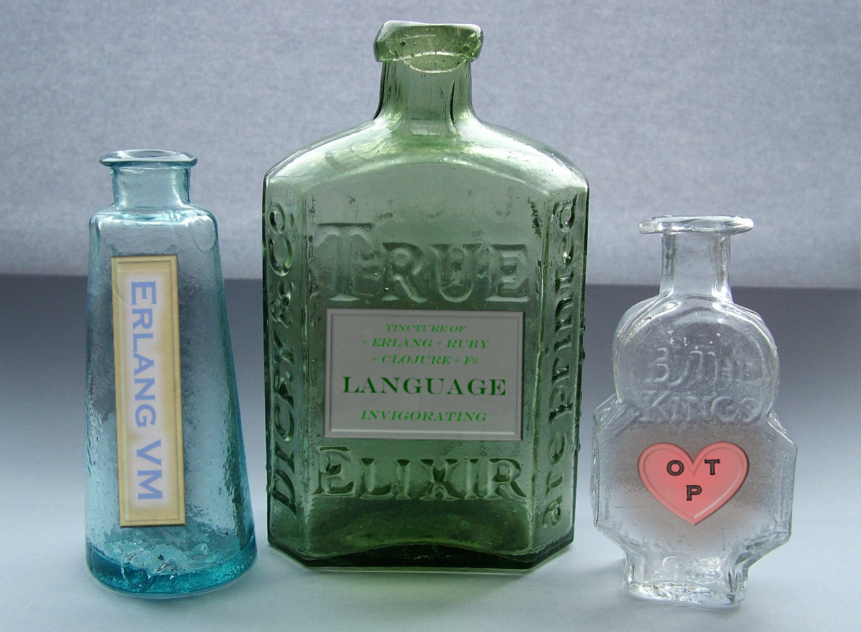
tincture of + Erlang + Ruby + Clojure + F# Language Invigorating
Erlang VM
O T P
Notes:
What in the world is that?
>>>
WikiMedia commons
http://commons.wikimedia.org/wiki/File:Three_early_medicine_bottles.jpg

Slide 20
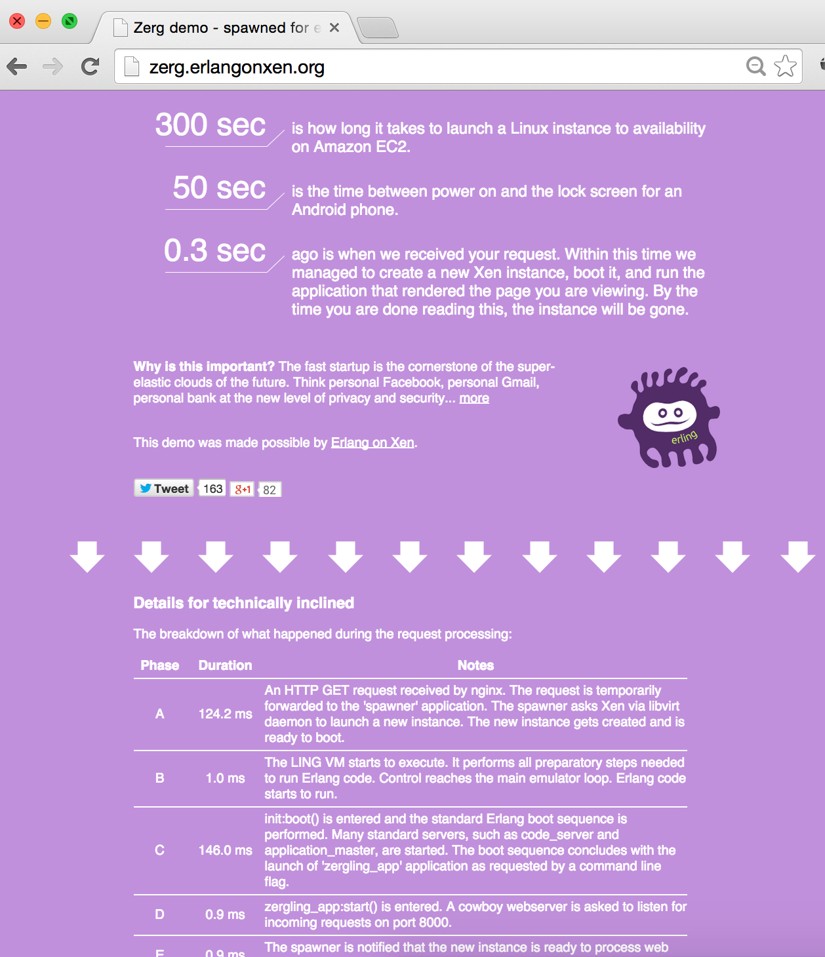


Elixir in Context
Erlang / Elixir / LFE
OTP
Hundreds of dev years
ERTS
VM + Kernel
+ STDLIB
OS (Windows, Linux, Mac, None)
Notes:
the Erlang VM doesn't look like a normal
06:08
stack here so we've got this OS Windows
06:12
Linux Mac and so on we have this Erlang
06:14
VM of this Erlang runtime system here
06:16
and it's way down into the territory of
06:19
that box where you'd normally be up on
06:20
top of these operating systems so the
06:22
Erlang B M is an operating system it's
06:26
not a peer of the JVM it's not a peer
06:29
the CLR the.net CLR it is an operating
06:32
system it can run on top of other
06:35
operating systems like Windows Linux Mac
06:37
and so on it can run different hardware
06:38
architectures raspberry pi you've
06:40
probably seen the nerves content just
06:42
just stunning stuff there but up on top
06:45
of that operating system we have a set
06:46
of libraries that were built at Ericsson
06:49
called OTP open telecom platform and so
06:51
these were these libraries that that
06:54
they had built all the way from 86 on to
06:56
now just making more more stable of how
06:58
you build these core bits of of software
07:01
all the lessons learn battle-tested
07:03
lessons and there
07:04
these reusable patterns that are cooking
07:06
they're there these libraries and and
07:08
then just general patterns as well that
07:10
makes up o TP on top we have these
07:13
languages and these languages on top
07:15
they compile to the beam so beam B am is
07:19
the is the byte code that that you
07:22
compile down to from Erlang and from
07:24
elixir so are laying a lick sir
07:26
absolutely the same as far as early and
07:27
VM is concerned and this is our first
07:32
reason of why
07:33
josée didn't just say I'm gonna take
07:36
the good ideas from Erlang and bring
07:38
back to Ruby because there were hundreds
07:40
of developer years put into the Erlang
07:42
VM so that's a lot of work to bring back
07:44
and it had this track record it was
07:46
doing all these amazing things and so
07:48
instead of doing that you come over to
07:51
this thing now I want you to see this
07:52
nun over here this is interesting I'm
07:54
just gonna point out a couple of
07:55
examples so here's one or laying on Zin
07:59
if you do a search for this it's a
08:02
pretty cool project this is bare-metal
08:03
hypervisor runs on the bare metal on the
08:06
Xen hypervisor which Amazon ec2 uses and
08:10
so you can spin up boxes there there's a
08:12
demo here that will bring up an instance
08:14
of of Erlang guns in and service your
08:19
web request send the response back the
08:22
server gets destroyed goes away and that
08:24
Holl happens in the see the 0.3 seconds
08:31
there so booting into a server web
08:35
server response comes back point three
08:37
seconds we also have another several
08:41
projects along this line but grip is
08:42
bare metal on this embedded device so
08:45
this is one to search about very cool
08:46
stuff but it's outside of the scope what
08:48
we're talking about here so we now have
08:52
to think about

Slide 21
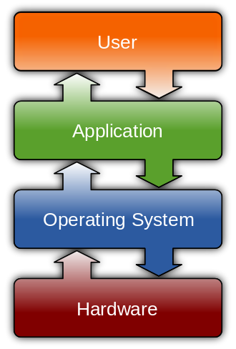
What does an OS do?
Process management
Interrupts
Memory management
File system
Networking
I / O
http://en.wikipedia.org/wiki/Operating_system
Notes:
we know are laying VM is
08:55
an operating system so what is it that
08:56
operating system is even responsible for
08:58
and so it's about process management
09:00
interrupt scheduling memory management
09:03
filesystem stuff networking all these
09:05
bits and this is early and VM takes on
09:07
this it doesn't count on there's like
09:09
for example there's not even concept of
09:10
threads inside of the Erlang VM so all
09:13
these operating system concepts they
09:14
don't bubble up it's a different
09:15
abstraction

Slide 22
What does an App (C/C#/JS/…) do?
Eat brains…
Brains!
Brains!!!
http://en.wikipedia.org/wiki/Operating_system
Notes:
so what is it that an app
09:18
does
09:18
so if you write your C code your c-sharp
09:20
your JavaScript well it has a different
09:22
job this job is to go out there and eat
09:24
brains brains brains

Slide 23

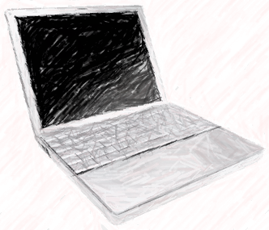
Notes:
because it's
09:29
full-time job is to try to get as much
09:30
core as it can it's trying to do it
09:33
sprint to perform as fast as it can it's
09:35
trying to get this job done and it
09:36
doesn't care anything about the job of
09:38
the operating system and the operating
09:40
system the result is in this battle with
09:42
it's like this zombie warfare going on
09:44
between the operating system and these
09:46
processes it can't trust anything
09:48
everything's bitey out there is trying
09:49
to get his hands on you and so the
09:51
operating system has to lock down memory
09:54
these costly painful contact switches
09:56
between things as you switch back and
09:58
forth no trust no trust no trust so it
10:01
can be different than that though

Slide 24
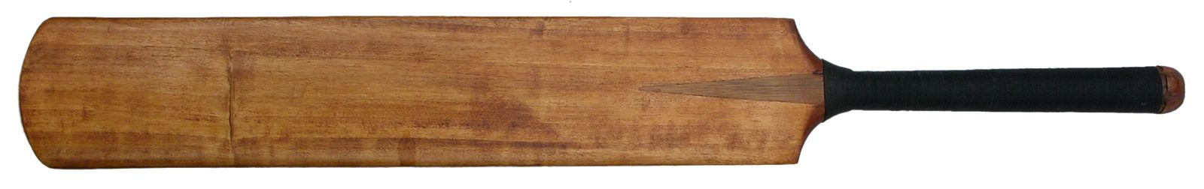
ErlangVM Processes
Notes:
>>> TIME: 10:40 <<< and it
10:03
is different than that on the early on
10:04
here darling VM isn't a general purpose
10:08
operating system it's a special purpose
10:10
operating system and it's special
10:12
purpose is to make sure that beam code
10:14
has a rock-solid place to go off and be
10:17
awesome and so that is us you know we're
10:22
we're riding our beam code we're riding
10:23
our elixir code and this VM it's
10:25
full-time job is to make sure that we
10:27
get everything that we need and it knows
10:29
it can trust us because it's not that it
10:31
knows we're good people of course we are
10:33
but it knows that's not why it knows
10:35
that we can't break the rules they
10:37
agreed on the rules
>>>
WikiMedia commons
http://commons.wikimedia.org/wiki/File:Cricket_bat_01.jpg
By Lionel Allorge (Own work) [GFDL (http://www.gnu.org/copyleft/fdl.html) or CC BY-SA 3.0 (http://creativecommons.org/licenses/by-sa/3.0)], via Wikimedia Commons

Slide 25
Interactive Elixir (IEX)
$ ▊
Notes:
and so now we're
10:40
gonna see a little bit about this model
10:42
in action

Slide 26
Interactive Elixir (IEX)
$ iex▊
Notes:
so here we have the shell
interactive elixir so IEX

Slide 27
Interactive Elixir (IEX)
$ iex Erlang/OTP 20 [erts-9.0] Interactive Elixir (1.5.1)
iex(1)> ▊
Notes:
we come in and
10:52

Slide 28
Interactive Elixir (IEX)
$ iex Erlang/OTP 20 [erts-9.0] Interactive Elixir (1.5.1)
iex(1)> self()▊
Notes:
we type in self

Slide 29
Interactive Elixir (IEX)
$ iex Erlang/OTP 20 [erts-9.0] Interactive Elixir (1.5.1)
iex(1)> self() #PID<0.84.0> iex(2)> ▊
Notes:
we see a process ID so
10:56
even the shell itself is a process
10:58
everything's a processes processes all
11:00
the way down

Slide 30
Concurrency
Notes:
and elixir ok let's talk
11:04
just a bit about concurrency

Slide 31
‘86
‘06
≠
Concurrency
Parallelism
structure
execution
lots of things at once
Notes:
because
11:06
this is a one that's easy for people to
11:07
mix up
concurrency and
11:09
parallelism they're not the same thing
11:12
so concurrency is about the structure of
11:15
lots of things at once and parallelism
11:18
was about the execution of lots of
11:20
things at once
11:21
and so if it were about parallelization
11:24
it would have never happened i ed
11:26
erickson you would have had back in 86
11:29
they didn't have multi-core boxes that
11:30
they were running or
11:32
laying on then they what they need to do
11:35
is they need to be able to reason about
11:36
lots of things at once and it just turns
11:38
out that model works really really well
11:40
and so in 2006 they were able to flip
11:43
the switch go to multi core have multi
11:45
schedulers and processes of code they've
11:47
been written ten years before deployed
11:49
to new Erlang in 2006 two cores ran
11:53
twice as fast for core and four times as
11:55
fast and there were cases of good Orlan
11:57
code that would shown to scale linearly
11:59
up to 40 cores which is crazy awesome
12:02
it's a total moonshot that happened
12:04
there

Slide 32
Elixir, the Erlang VM, and the Actor model
Notes:
>>> TIME: 12:00 <<<
so let's look about these processes
12:07
let's learn a little bit more
>>>
https://commons.wikimedia.org/wiki/Category:Hamlet#/media/File:CharlesFechter001.JPG

Slide 33
The props of every actor
Memory
Mailbox
Garbage Collector
Links & Monitors
Notes:
https://commons.wikimedia.org/wiki/File:Edwin-Booth-Hamlet-1870.png

Slide 34
The props of every process
Memory
Mailbox
Garbage Collector
Links & Monitors
Notes:
https://commons.wikimedia.org/wiki/File:Edwin-Booth-Hamlet-1870.png

Slide 35
One Kilobyte
Two KB (on 64-bit)
Memory
heap
Mailbox
stack
Garbage Collector
Links & Monitors
Notes:
so every
12:09
actor every process has some props so
12:14
the first of these props is memory so
12:17
each of these processes they have their
12:19
own dedicated isolated share noting
12:22
memory and it's tiny it starts off tiny
12:25
anyway it's a kilobyte 32-bit system a
12:28
couple kilobytes on a 64-bit system and
12:30
inside of that we have this heap in the
12:32
stack and as we build up our processes
12:34
are running in the accumulate state and
12:36
so on it grows and it grows following
12:37
this Fibonacci series so they can grow
12:39
and grow and after it grows though it
12:42
can be garbage collected okay each
12:45
process gets its own garbage collector
12:48
so let that sink in for a second we've
12:51
got hundreds of thousands of processes
12:52
running on a box and each one of them
12:54
has their own isolated garbage collector
12:55
so you think about this job of garbage
12:57
collector on a vmware it's functional
13:00
you can't mutate state and you have no
13:03
shared state between processes it's not
13:05
a bad place to be a garbage collector
13:06
and we get something out of this this
13:09
wasn't just to be awesome and cool
13:10
there's plenty of things and that
13:12
happened there this was around again
13:13
high availability fault tolerance when
13:16
you have these even these tiny
13:18
deterministic GCS that happen you don't
13:20
have a stop the world GC that brings
13:21
your whole server down when things get
13:23
busy and you're putting off a GC putting
13:24
off a GC and this I got out of GC and
13:26
and so that kills availability on some
13:30
systems JVM CLR you'll see that happen
>>>
https://commons.wikimedia.org/wiki/File:Edwin-Booth-Hamlet-1870.png

Slide 36
Easiest GC job in the world
Memory
Mailbox
Garbage Collector
Links & Monitors
Notes:
https://commons.wikimedia.org/wiki/File:Edwin-Booth-Hamlet-1870.png

Slide 37
Memory
Mailbox
Garbage Collector
Links & Monitors
Notes:
all right every process gets its own
13:35
dedicated mailbox and it's a good thing
13:39
because this is the only way a process
13:41
can talk to the outside world
13:43
it's absolutely lonely being
13:45
erling process
>>>
https://commons.wikimedia.org/wiki/File:Edwin-Booth-Hamlet-1870.png

Slide 38
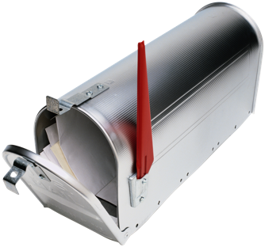
Alas, poor Yorick!
send(skull_pid, {:alas, “poor Yorick!”})
How about side effects?
Memory
Mailbox
Garbage Collector
Links & Monitors
Notes:
you have this message box
13:47
this mailbox and you can send things out
13:49
of the mailbox to another process and
13:51
you can receive things back in your
13:53
mailbox and you can choose when to send
13:55
and when to receive things can
13:56
accumulate in your mailbox you don't
13:58
have to just accept it then it's up to
14:00
you whenever you fall in your receive
14:01
block now this is real here so like it's
14:05
not just sometimes you talk through the
14:06
mailbox when you need to do something
14:08
you talk to the outside world is every
14:09
time including file i/o talking to the
14:13
network this is all message passing so
14:15
if you've done file i/o you probably
14:16
said file read file right something like
14:18
that what you're doing in the background
14:19
though you're talking to a process and
14:22
back in the back it's doing gen server
14:24
talk it's talking back to a port driver
14:26
so anytime we're dealing not we just do
14:28
the process but anytime we're dealing
14:30
with the outside world we're tall
14:31
dealing with side effects we're going
14:34
through a port driver and so in a funny
14:37
way as you run across Erlang and you see
14:39
this this this ecosystem there are at
14:41
least functional concepts but they're
14:43
not the same as you'd see another Stax
14:44
like the idea of like a monad the IO
14:47
monad to protect you from side effects
14:48
and so on it's hidden underneath this
14:51
layer port drivers and that's where all
14:52
the isolation is but we have these
14:54
guarantees inside of the mailbox and
14:55
message passing this copy only message
14:57
passing which is pretty darn cool
>>>
https://commons.wikimedia.org/wiki/File:Edwin-Booth-Hamlet-1870.png

Slide 39
Memory
Mailbox
Link a death pact (bidirectional)
Garbage Collector
Links & Monitors
Monitor reading the obituaries (unidirectional)
Notes:
okay
15:01
so and then the last thing that we're
15:03
going to talk about as far as processes
15:05
is what they come with is links and
15:07
monitors and so when we talked about
15:09
that process being able to like that
15:10
phone call crashes and you're able to
15:12
bring that phone call back maybe even
15:14
before the call or even notices anything
15:15
happened anything weird happened you do
15:17
this through links and monitors so a
15:19
link is like a death pact it's like this
15:21
process if that process dies I'm gonna
15:24
die too and if I die it's gonna die your
15:26
you have this death pact with the other
15:28
process we have to work together or we
15:30
can't work at all and this other ideas
15:32
monitors that's where I want to know if
15:34
you die I'm reading the obituaries
15:35
rather than actually signing up on the
15:37
death pact it's like I want to know I
15:39
care about you but I'm not willing to
15:40
you know go out with you
>>>
https://commons.wikimedia.org/wiki/File:Edwin-Booth-Hamlet-1870.png

Slide 40
Process Scheduling on the Erlang VM
Notes:
>>> TIME : 16:00 <<<
okay so now
15:43
let's look at how this all orchestrates

Slide 41
*
*
*
CPU Core
Notes:
when we have more than one of these
15:47
things so process scheduling we have a
15:50
single CPU core we get a single
15:52
scheduler

Slide 42
Near-zero context switching cost
*
*
*
Reductions
- Do 2,000 operations
reduction1 reduction3 .
Reduction2000
- Move to the next guy - Repeat
CPU Core
Notes:
so we have three processes
15:55
running up on this this Erlang VM we got
15:58
our elixir
15:59
is running one two three and we have
16:03
this game here called reductions so each
16:06
process the scheduler gives two thousand
16:09
swipes at the core and there's a zero
16:12
almost zero context switching cost as
16:14
you go from process one to two so we see
16:16
chunka chunka chunka chunka chunka
16:18
chunka chunka chunka chunka and then it
16:21
repeats back to process one now there's
16:23
nothing that process one can do to hog
16:25
the core and hold it this is pre-emptive
16:28
scheduling here so it takes the talking
16:31
stick away after 2000 even it's in the
16:33
middle of calculating pi it doesn't
16:35
matter if it's trying to be a hog or not
16:36
it just removes that everyone gets to
16:38
even swipe

Slide 43

Near-zero context switching cost
Scheduler
process
process
process
OOOOOOOOOO
process
process
process
process
process
process
OOOOOO`OOOO
OOOOOOOOOO
CPU Core
Notes:
here's another visualization
16:41
that same thin

Slide 44
Scheduler
Scheduler
process
process
process
process
process
OOOOOOOOOO
process
OOOOOOOOOO
process
process
process
process
process
process
process
process
process
process
process
process
OOOOOO`OOOO
OOOOOO`OOOO
OOOOOOOOOO
OOOOOOOOOO
CPU Core
CPU Core

Slide 45
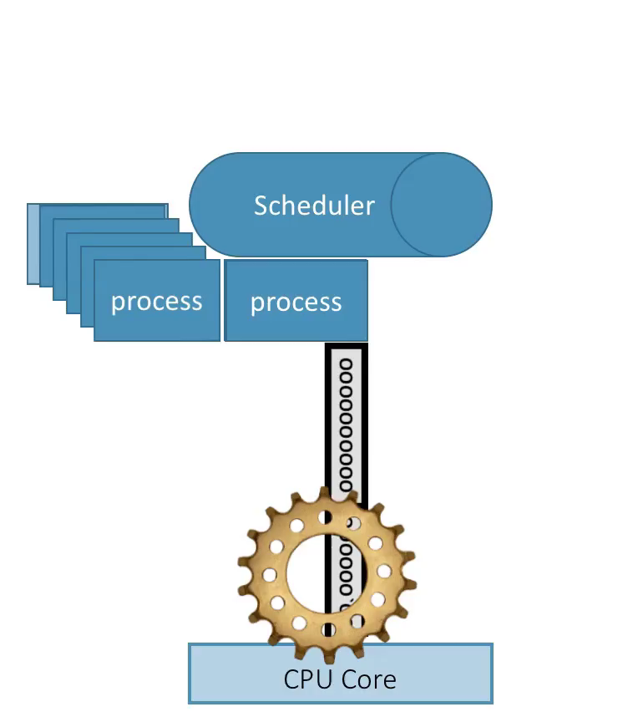
Notes:
and if we get multiple
16:46
cores
16:46
we get two schedulers one per core and
16:50
they're chucking along and parallel then
16:52
and so on and you won't believe this is
16:57
actually a PowerPoint animation so
16:59
that's yeah

Slide 46
Supervision and “let-it-crash”
worker
supervisor
*
*
CPU Core
Notes:
so alright so let's look at
17:05
supervision in this idea of letting it
17:07
crash so here we have two processes a
17:09
supervisor and a worker and if the
17:12
worker is going along and it is chunking
17:15
chunking chunking and it's talking to
17:16
the network and something weird goes on
17:18
on the network there's some sort of blip
17:19
it crashes supervisor restarts it and
17:23
the worker returns to its last you know
17:25
- its - its - a known good state yeah
17:27
where it was that when it was spawned or
17:29
so on

Slide 47
Process pairs – a common pattern to restore state
worker_a2
worker_a1
supervisor
*
*
*
CPU Core

Slide 48
Process pairs – a common pattern to restore state
I was in the library, the Restricted Section, and I read about an odd bit of rare magic.
It's called, as I understand it... Horcruxes.
worker_a2
worker_a1
supervisor
*
*
*
*
CPU Core

Slide 49
receive
*
*
*
CPU Core
Notes:
so on okay now let's look at three
17:33
processes here we got one chugging along
17:35
one chunking along and says hey I'm
17:38
gonna wait and look in my mailbox and
17:39
see if there's anything there I'm gonna
17:40
fall into receive block I don't really
17:41
have anything to do until I see
17:42
something there okay it falls in this
17:44
receive block and it's gonna block
17:46
forever it's gonna block block block and
17:49
no one's sending it messages so it's
17:50
gonna block have we just wrecked the
17:52
whole show have we got a single threaded
17:55
event loop where we're blocking and the
17:56
whole show falls down and and got that
17:59
mess that's not what we have it all here
18:01
we have this what happens here when this
18:03
guy blocks it's not a bad thing it's
18:05
actually a really good thing because
18:06
then what happens is the scheduler
18:08
rotates that process out of the loop and
18:11
the early VM
18:12
brother bringing it back into the loop
18:14
until it knows that it has a message in
18:17
its mailbox so that's pretty cool and
18:20
then our next process carries on

Slide 50
receive
*
*
*
CPU Core
Notes:
For Node, async IO s the pony's only trick. On the ErlangVM async IO is just built in through good, simple design.

Slide 51
***** *****
***** *****
***** *****
***** *****
Core
Core
Core
Core

Slide 52
Scheduler migration : a game of balancing and compaction
***** *****
***** *****
***** *****
***** *****
Core
Core
Core
Core
Notes:
>>> TIME 18:30 <<<

Slide 53
Compaction for energy saving & memory locality
***** *****
***** *****
****
***
Core
Core
Core
Core

Slide 54
Compaction for energy saving & memory locality
Busy ☺
Busy ☺
work stealing!
***** *****
***** *****
****
***
Core
Core
Core
Core

Slide 55
Compaction for energy saving & memory locality
Busy ☺
Busy ☺
work stealing!
***** *****
***** *****
****
***
Core
Core
Core
Core

Slide 56
Compaction for energy saving & memory locality
Busy ☺
Busy ☺
work stealing!
***** *****
***** *****
****
***
Core
Core
Core
Core

Slide 57
Compaction for energy saving & memory locality
Busy ☺
Busy ☺
Busy ☺
Sleepy ☺
***** *****
***** *****
**** ***
Core
Core
Core
Core

Slide 58
***** *****
***** *****
***** *****
*
Core
Core
Core
Core

Slide 59
Scheduler migration : balance to prevent overburden
***** ***** *****
***** *****
***** *****
*
Core
Core
Core
Core

Slide 60

Scheduler migration : balance to prevent overburden
***** ***** ***** *****
***** *****
***** *****
*
Core
Core
Core
Core
Notes:
"DIN 4844-2 Warnung vor feuergefaehrlichen Stoffen D-W001" by Torsten Henning - drawn by author. Licensed under Public domain via Wikimedia Commons - http://commons.wikimedia.org/wiki/File:DIN_4844-2_Warnung_vor_feuergefaehrlichen_Stoffen_D-W001.svg#mediaviewer/File:DIN_4844-2_Warnung_vor_feuergefaehrlichen_Stoffen_D-W001.svg

Slide 61
Scheduler migration : balance to prevent overburden
work stealing!
***** ***** ***** *****
***** *****
***** *****
*
Core
Core
Core
Core
Notes:
"DIN 4844-2 Warnung vor feuergefaehrlichen Stoffen D-W001" by Torsten Henning - drawn by author. Licensed under Public domain via Wikimedia Commons - http://commons.wikimedia.org/wiki/File:DIN_4844-2_Warnung_vor_feuergefaehrlichen_Stoffen_D-W001.svg#mediaviewer/File:DIN_4844-2_Warnung_vor_feuergefaehrlichen_Stoffen_D-W001.svg

Slide 62
Scheduler migration : balance to prevent overburden
work stealing!
***** *****
***** *****
***** *****
***** *****
Core
Core
Core
Core

Slide 63
massive concurrency preemptive multitasking
soft real-time low latency over raw throughput
***** *****
***** *****
***** *****
***** *****
Core
Core
Core
Core

Slide 64
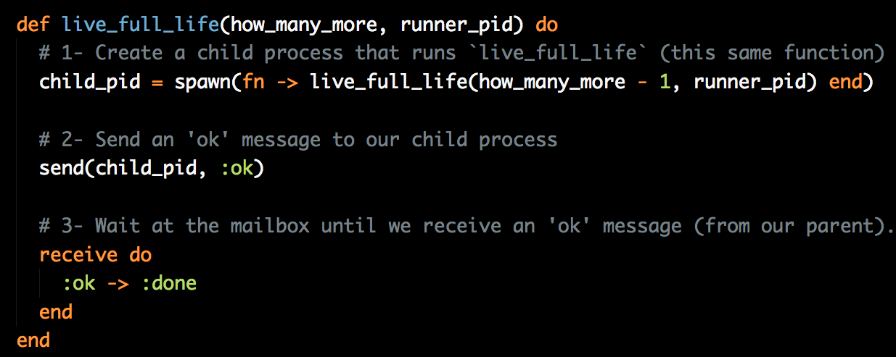
The performance of a concurrent language is predicated by three things:
the context-switching time
the message passing time, and
the time to create a process.
- Mike Williams (co-inventor or Erlang)
Notes:
>>> TIME 20:00 <<<

Slide 65
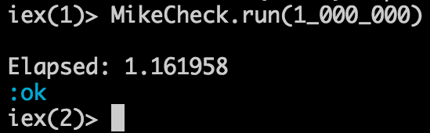
https://github.com/bryanhunter/elixir-by-the-bellyful

Slide 66
Simplified distribution

Slide 67
Time for a demo?
$ ▊
nodes
$ ▊
$ ▊
Notes:
15 minutes left?

Slide 68
tincture of + Erlang + Ruby + Clojure + F# Language Invigorating
Erlang VM
O T P
Notes:
WikiMedia commons
http://commons.wikimedia.org/wiki/File:Three_early_medicine_bottles.jpg

Slide 69
Safety & fault-tolerance

Slide 70
GenServer
Supervisor
Application

Slide 71
GenServer
defmodule Chunko.Worker do
use GenServer
# Client API
def start() do
GenServer.start_link(__MODULE__, [])
end
def bump_level(pid, amount) do
GenServer.call(pid, {:bump, amount})
end
# Callbacks
def init(_args) do
{:ok, %{level: 0}}
end
def handle_call({:bump, amount}, _from, state) do
new_level = state.level + amount
response = {:ok, new_level }
{:reply, response, %{state | level: new_level}}
end
end

Slide 72
GenServer
Module
Process
caller
iex(1)>
#PID<0.113.0>
client API
Chunko.Worker
callback
behaviour
GenServer (:gen_server, :gen)

Slide 73
GenServer
Module
Process
iex(1)>
#PID<0.113.0>
caller
start
client API
Chunko.Worker
init
#PID<0.115.0>
callback
start_link
behaviour
GenServer (:gen_server, :gen)

Slide 74
GenServer
Module
Process
iex(1)>
{:ok, <0.115.0>}
#PID<0.113.0>
caller
start
client API
Chunko.Worker
init
#PID<0.115.0>
callback
start_link
behaviour
GenServer (:gen_server, :gen)
set initial state

Slide 75
GenServer
defmodule Chunko.Worker do
use GenServer
# Client API
def start() do
GenServer.start_link(__MODULE__, [])
end
def bump_level(pid, amount) do
GenServer.call(pid, {:bump, amount})
end
# Callbacks
def init(_args) do
{:ok, %{level: 0}}
end
def handle_call({:bump, amount}, _from, state) do
new_level = state.level + amount
response = {:ok, new_level }
{:reply, response, %{state | level: new_level}}
end
end

Slide 76
[])
end
def bump_level(pid, amount) do
GenServer.call(pid, {:bump, amount})
end
GenServer
loop
# Callbacks
def init(_args) do
{:ok, %{level: 0}}
end
def handle_call({:bump, amount}, _from, state) do
new_level = state.level + amount
response = {:ok, new_level }
{:reply, response, %{state | level: new_level}}
end
end
receive
dispatch
send reply
update state

Slide 77
[])
end
def bump_level(pid, amount) do
GenServer.call(pid, {:bump, amount})
end
GenServer
loop
# Callbacks
def init(_args) do
{:ok, %{level: 0}}
end
def handle_call({:bump, amount}, _from, state) do
new_level = state.level + amount
response = {:ok, new_level }
{:reply, response, %{state | level: new_level}}
end
end
receive
dispatch
send reply
update state

Slide 78
[])
end
def bump_level(pid, amount) do
GenServer.call(pid, {:bump, amount})
end
GenServer
loop
# Callbacks
def init(_args) do
{:ok, %{level: 0}}
end
def handle_call({:bump, amount}, _from, state) do
new_level = state.level + amount
response = {:ok, new_level }
{:reply, response, %{state | level: new_level}}
end
end
receive
dispatch
send reply
update state

Slide 79
[])
end
def bump_level(pid, amount) do
GenServer.call(pid, {:bump, amount})
end
GenServer
loop
# Callbacks
def init(_args) do
{:ok, %{level: 0}}
end
def handle_call({:bump, amount}, _from, state) do
new_level = state.level + amount
response = {:ok, new_level }
{:reply, response, %{state | level: new_level}}
end
end
receive
dispatch
send reply
update state

Slide 80
Application
Supervisor
Supervisor
GenServer
GenServer
GenServer
GenServer
GenServer
GenServer

Slide 81
Code with a powerful REPL

Slide 82
Code with Tests, Docs, and DocTests

Slide 83
Code the happy path a.k.a.
"Let it crash"

Slide 84
The safest way
to code for concurrency is to code sequentially

Slide 85
"no masters"
99.9% (3-Nines)
99.9% (3-Nines)
99.9% (3-Nines)
99.9% (3-Nines)
99.8% uptime
99.9999% uptime
(17.52 hours per year)
(31.5 seconds per year)

Slide 86
tincture of + Erlang + Ruby + Clojure + F# Language Invigorating
Erlang VM
O T P
Notes:
>>>> TIME CHECK <<< Should be at 23:00
WikiMedia commons
http://commons.wikimedia.org/wiki/File:Three_early_medicine_bottles.jpg

Slide 87
Accessible
Notes:
>>> TIME: 29:00 <<<

Slide 88
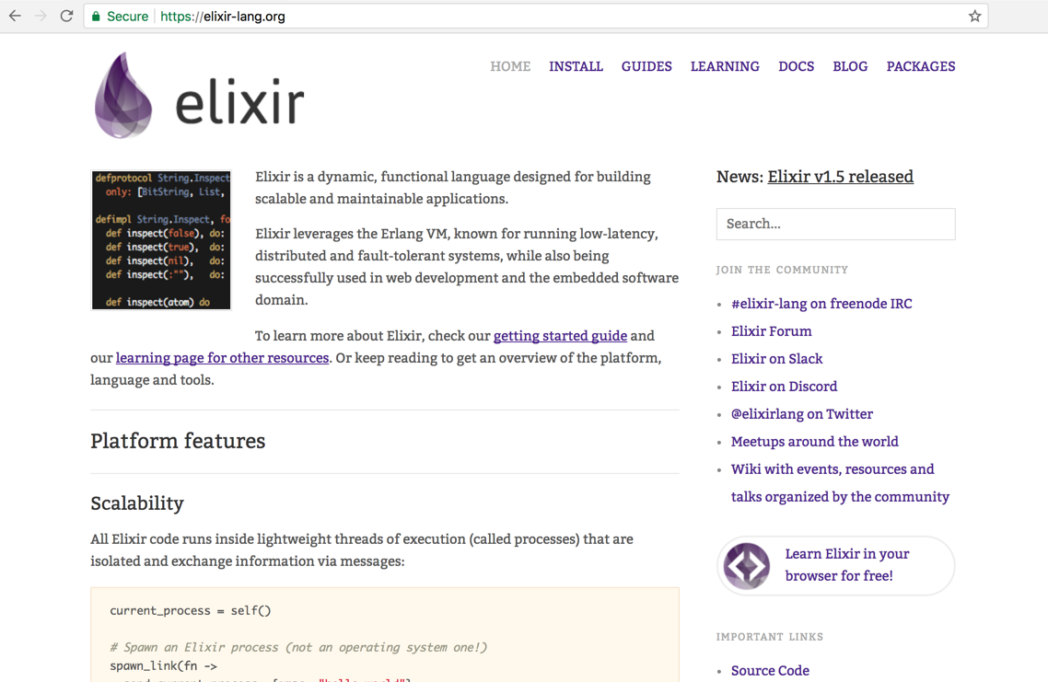
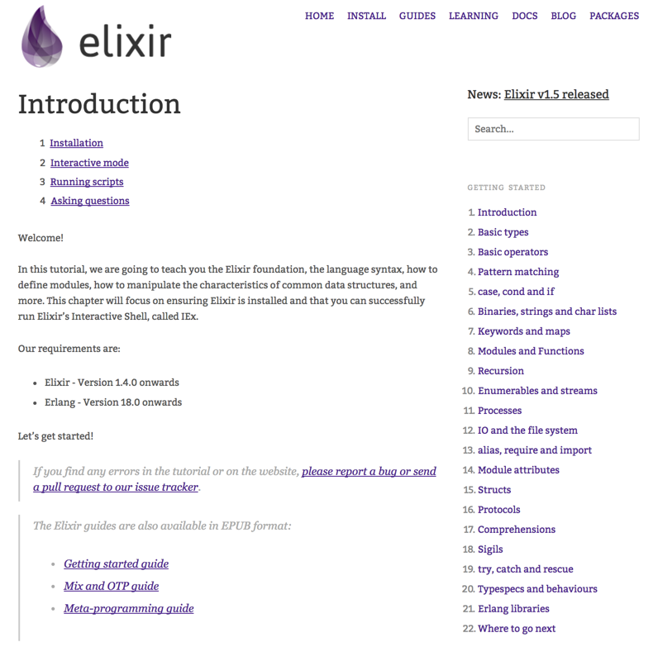

Slide 89
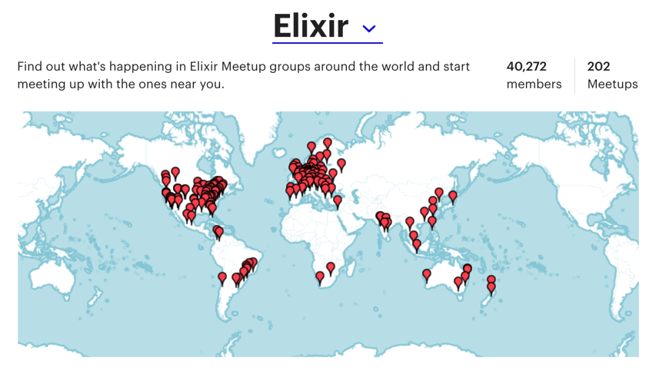

Slide 90
The Community is Warm

Slide 91
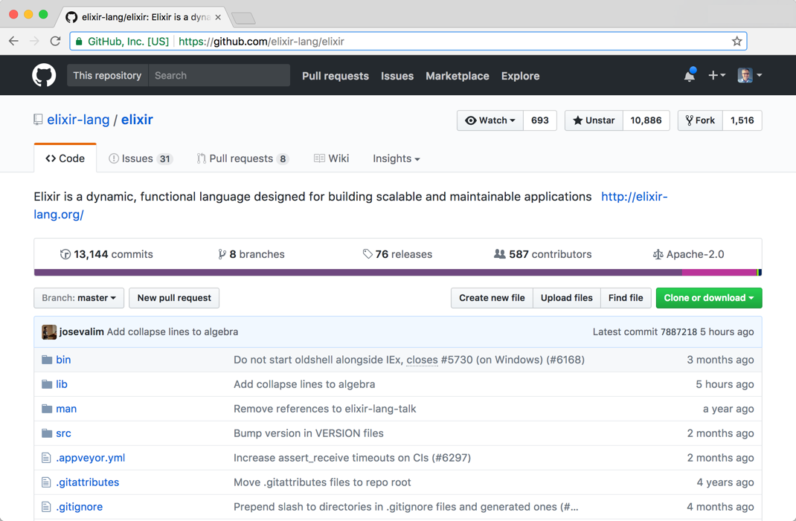
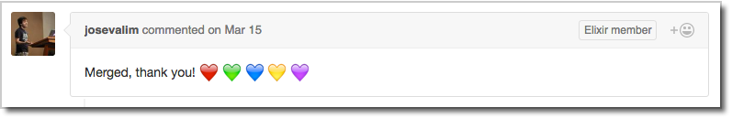

Slide 92
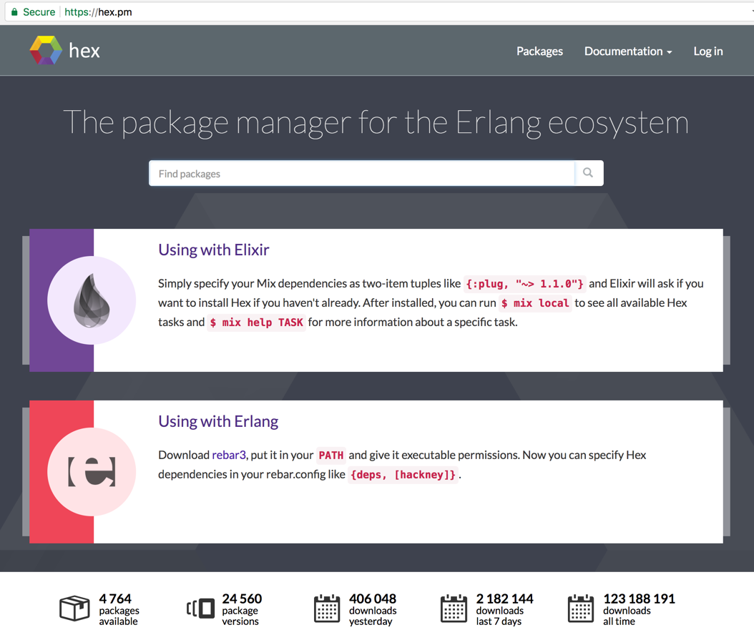
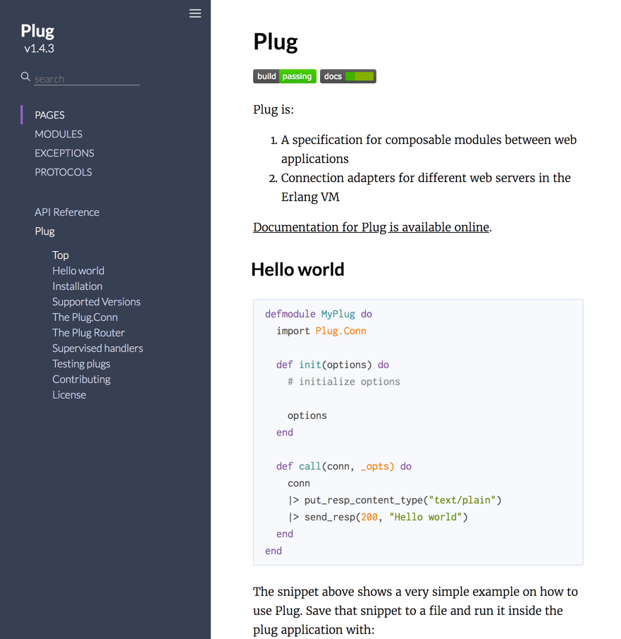
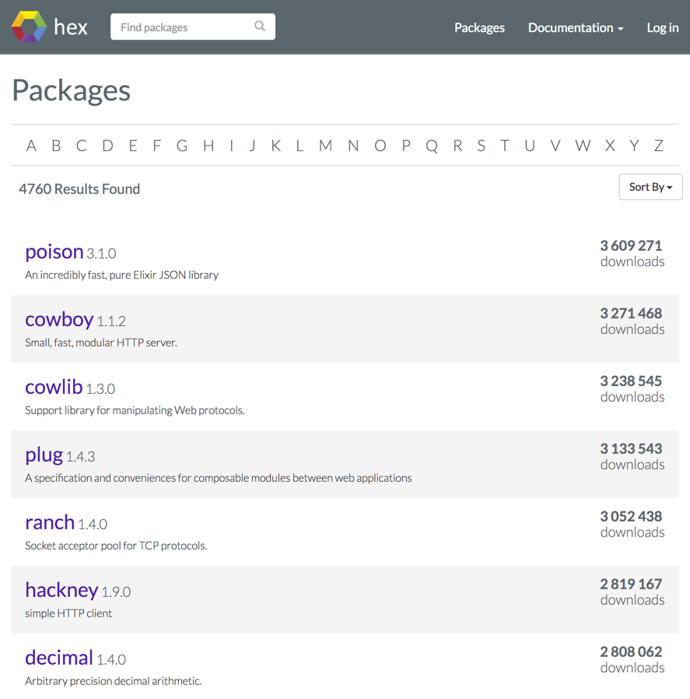

Slide 93
Approachable and productive with modern tooling

Slide 94
$
▊
By Yesterdays Antique Motorcycles. [GFDL or CC BY-SA 2.5], via Wikimedia Commons
Notes:
https://commons.wikimedia.org/wiki/File:MacMillan_bicycle_1842_replica.jpg

Slide 95
Always helpful
iex(1)> ▊

Slide 96
Always helpful
iex(1)> h▊

Slide 97
Always helpful
iex(1)> h Enum▊

Slide 98
Always helpful
iex(1)> h Enum.c▊

Slide 99
Always helpful
iex(1)> h Enum.c
chunk_by/2 chunk_every/2 chunk_every/3 chunk_every/4 chunk_while/4 concat/1 concat/2 count/1 count/2
iex(1)> h Enum.c▊
[tab]

Slide 100
Always helpful
iex(1)> h Enum.c
chunk_by/2 chunk_every/2 chunk_every/3 chunk_every/4 chunk_while/4 concat/1 concat/2 count/1 count/2
iex(1)> h Enum.count/1▊
[tab]

Slide 101
Always helpful
chunk_every/4 chunk_while/4 concat/1 concat/2 count/1 count/2
iex(1)> h Enum.count/1
Returns the size of the enumerable. ## Examples
iex> Enum.count([1, 2, 3])
3
iex(2)> ▊
def count(enumerable)

Slide 102
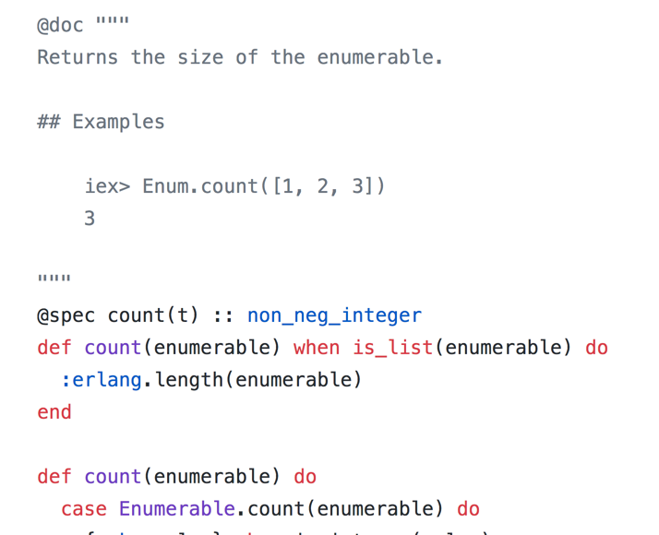
Always helpful
chunk_every/4 chunk_while/4 concat/1 concat/2 count/1 count/2
iex(1)> h Enum.count/1
Returns the size of the enumerable. ## Examples
iex> Enum.count([1, 2, 3])
3
iex(2)> ▊
I'm not just nice documentation… I'm a DocTest!
def count(enumerable)
/lib/elixir/lib/enum.ex

Slide 103
Mix
$ ▊

Slide 104
Mix
$ mix help▊

Slide 105
Mix
$ mix help
... mix # Runs the default task mix clean # Deletes generated application files
mix compile # Compiles source files
mix deps.get # Gets all out of date dependencies
mix dialyzer # Runs dialyzer
mix docs # Generate documentation
mix hex # Prints Hex help information
mix new # Creates a new Elixir project
mix phx.new # Creates a new Phoenix v1.3.0 applica
mix profile.fprof # Profiles the given file/expression
mix test # Runs a project's tests
iex -S mix # Starts IEx and runs the default task
(a ton more!)

Slide 106
Mix
$ ▊

Slide 107
Mix
$ mix ▊

Slide 108
Mix
$ mix new ▊

Slide 109
Mix
$ mix new fizz_buzz▊

Slide 110
Mix
$ mix new fizz_buzz
* creating README.md*
* creating .gitignore*
* creating mix.exs
* creating config * creating config/config.exs * creating lib * creating lib/fizz_buzz.ex * creating test * creating test/test_helper.exs * creating test/fizz_buzz_test.exs Your Mix project was created successfully. You can use "mix" to compile it, test it, and more: cd fizz_buzz mix test
Run "mix help" for more commands.
$ ▊

Slide 111
Mix
$ mix new fizz_buzz
* creating README.md*
* creating .gitignore*
* creating mix.exs
* creating config * creating config/config.exs * creating lib * creating lib/fizz_buzz.ex * creating test * creating test/test_helper.exs * creating test/fizz_buzz_test.exs Your Mix project was created successfully. You can use "mix" to compile it, test it, and more: cd fizz_buzz mix test
Run "mix help" for more commands.
$ code .▊

Slide 112
Mix
$ mix new fizz_buzz
* creating README.md*
* creating .gitignore*
* creating mix.exs
* creating config * creating config/config.exs * creating lib * creating lib/fizz_buzz.ex * creating test * creating test/test_helper.exs * creating test/fizz_buzz_test.exs Your Mix project was created successfully. You can use "mix" to compile it, test it, and more: cd fizz_buzz mix test
Run "mix help" for more commands.
$ clear▊

Slide 113
Mix
$ ▊

Slide 114
Mix
$ cd ▊

Slide 115
Mix
$ cd fizz_buzz▊

Slide 116
Mix
$ cd fizz_buzz $ ▊

Slide 117
Mix
$ cd fizz_buzz $ mix ▊

Slide 118
Mix
$ cd fizz_buzz $ mix test▊

Slide 119
Mix
$ cd fizz_buzz $ mix test Compiled lib/fizz_buzz.ex Generated fizz_buzz app Consolidated List.Chars Consolidated Collectable Consolidated String.Chars Consolidated Enumerable Consolidated IEx.Info Consolidated Inspect . Finished in 0.04 seconds (0.04s on load, 0.00s on tests) 1 test, 0 failures Randomized with seed 335843 $ ▊

Slide 120
Mix
$ cd fizz_buzz $ mix test Compiled lib/fizz_buzz.ex Generated fizz_buzz app Consolidated List.Chars Consolidated Collectable Consolidated String.Chars Consolidated Enumerable Consolidated IEx.Info Consolidated Inspect . Finished in 0.04 seconds (0.04s on load, 0.00s on tests) 1 test, 0 failures Randomized with seed 335843 $ code .▊

Slide 121
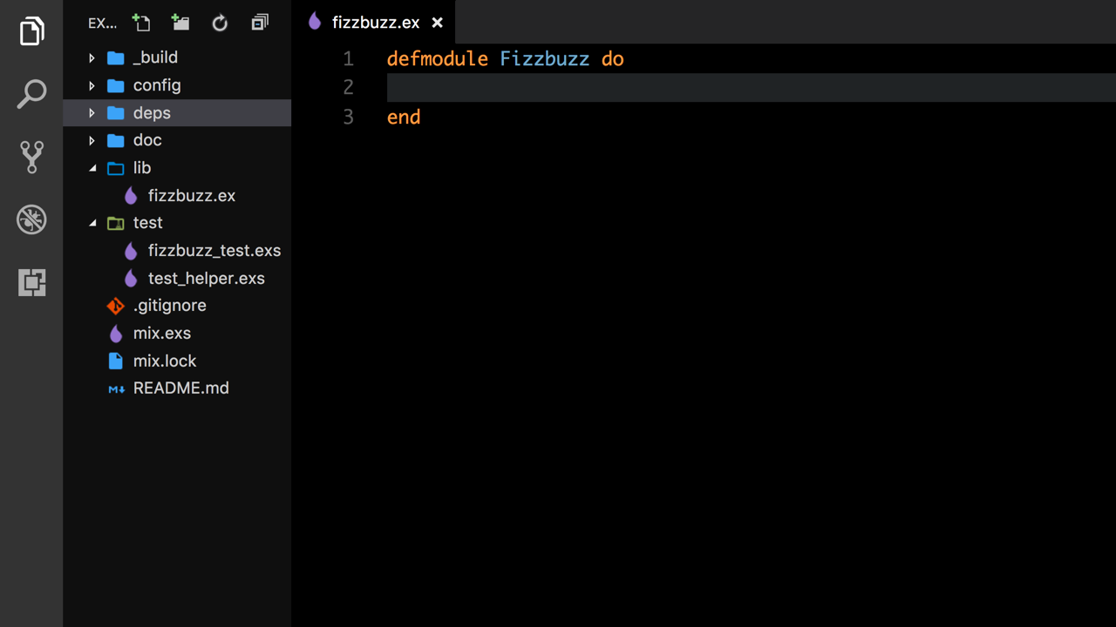
Demo time?

Slide 123
Expressive Developer Joy
Notes:
>>> TIME CHECK Should be at 26:00
doc tests - gave me happiness
bit syntax
typespecs
Unicode
MIME type
Timex updates running code with new time file, a new leap second is introduced.

Slide 124
types
iex> ▊

Slide 125
types
iex> 2016 # integer
2016
iex> ▊

Slide 126
types
iex> 2016 # integer
2016
iex> 0x2a # integer 42
iex> ▊

Slide 127
types
iex> 2016 # integer
2016
iex> 0x2a # integer 42
iex> 7.0 / 3 # float
2.3333333333333335 iex> ▊

Slide 128
types
iex> 2016 # integer
2016
iex> 0x2a # integer 42
iex> 7.0 / 3 # float
2.3333333333333335 iex> :the_thing_itself # atom
:the_thing_itself
iex> ▊

Slide 129
types
iex> 2016 # integer
2016
iex> 0x2a # integer 42
iex> 7.0 / 3 # float
2.3333333333333335 iex> :the_thing_itself # atom
:the_thing_itself
iex> "elixir" # string "elixir"
iex> ▊

Slide 130
types
iex> 2016 # integer
2016
iex> 0x2a # integer 42
iex> 7.0 / 3 # float
2.3333333333333335 iex> :the_thing_itself # atom
:the_thing_itself
iex> "elixir" # string "elixir"
iex> [1, 23, :goat] # list
[1, 23, :goat]
iex> ▊

Slide 131
types
iex> 2016 # integer
2016
iex> 0x2a # integer 42
iex> 7.0 / 3 # float
2.3333333333333335 iex> :the_thing_itself # atom
:the_thing_itself
iex> "elixir" # string "elixir"
iex> [1, 23, :goat] # list
[1, 23, :goat]
iex> {1, "second", :third} # tuple
{1, "second", :third}
iex> ▊

Slide 132
iex(1)> ▊

Slide 133
iex(1)> x = 5▊

Slide 134
iex(1)> x = 5 5 iex(2)> ▊

Slide 135
iex(1)> x = 5 5 iex(2)> 5 = x▊

Slide 136
iex(1)> x = 5 5 iex(2)> 5 = x 5 iex(3)> ▊

Slide 137
iex(1)> x = 5 5 iex(2)> 5 = x 5 iex(3)> y = x▊

Slide 138
iex(1)> x = 5 5 iex(2)> 5 = x 5 iex(3)> y = x 5 iex(4)> ▊

Slide 139
Immutability

Slide 140
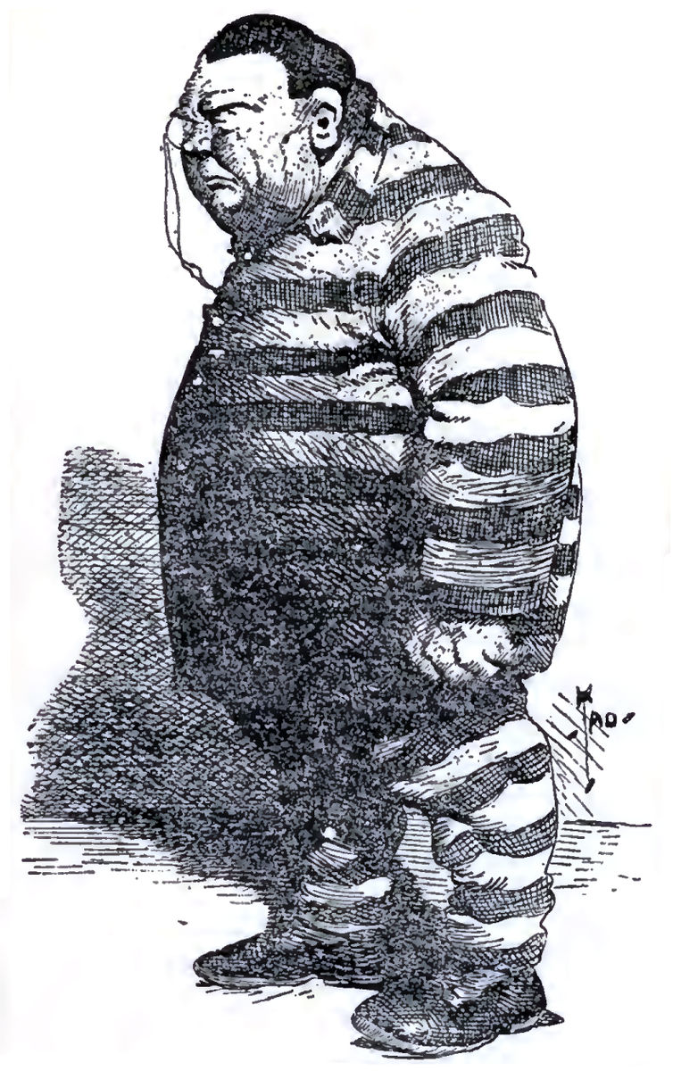
Notes:
Public domain: https://commons.wikimedia.org/wiki/File:Murphy-Cartoon-1905.jpg

Slide 141
iex(1)> ▊
Notes:
Public domain: https://commons.wikimedia.org/wiki/File:Murphy-Cartoon-1905.jpg

Slide 142
iex(1)> x = 5▊
Notes:
Public domain: https://commons.wikimedia.org/wiki/File:Murphy-Cartoon-1905.jpg

Slide 143
iex(1)> x = 5 5 iex(2)> ▊
Notes:
Public domain: https://commons.wikimedia.org/wiki/File:Murphy-Cartoon-1905.jpg

Slide 144
iex(1)> x = 5 5 iex(2)> x = x + 1▊
Notes:
Public domain: https://commons.wikimedia.org/wiki/File:Murphy-Cartoon-1905.jpg

Slide 145
Wat?
iex(1)> x = 5 5 iex(2)> x = x + 1 6 iex(3)> ▊
Notes:
Public domain: https://commons.wikimedia.org/wiki/File:Murphy-Cartoon-1905.jpg

Slide 146
iex(1)> x = 5 5 iex(2)> x = x + 1 6 iex(3)> ▊
Rebinding
Notes:
Public domain: https://commons.wikimedia.org/wiki/File:Murphy-Cartoon-1905.jpg

Slide 147
iex(1)> x = 5 5 iex(2)> x = x + 1 6 iex(3)> ^x = 6▊
Rebinding
Notes:
Public domain: https://commons.wikimedia.org/wiki/File:Murphy-Cartoon-1905.jpg

Slide 148
iex(1)> x = 5 5 iex(2)> x = x + 1 6 iex(3)> ^x = 6 6 iex(4)> ▊
Rebinding
Pinning
Notes:
Public domain: https://commons.wikimedia.org/wiki/File:Murphy-Cartoon-1905.jpg

Slide 149
iex(1)> x = 5 5 iex(2)> x = x + 1 6 iex(3)> ^x = 6 6 iex(4)> ^x = x + 1▊
Rebinding
Pinning
Notes:
Public domain: https://commons.wikimedia.org/wiki/File:Murphy-Cartoon-1905.jpg

Slide 150
iex(1)> x = 5 5 iex(2)> x = x + 1 6 iex(3)> ^x = 6 6 iex(4)> ^x = x + 1 ** (MatchError) no match of right hand side value: 7 iex(4)> ▊
Rebinding
Pinning
Notes:
Public domain: https://commons.wikimedia.org/wiki/File:Murphy-Cartoon-1905.jpg

Slide 151
pattern matching
iex(1)> x = 5 5 iex(2)> 5 = x 5 iex(3)> y = x 5 iex(4)> x = 10 10 iex(5)> ▊
Binding
Matching
Wat?
Rebinding

Slide 152
pattern matching
iex(1)> x = 5 5 iex(2)> 5 = x 5 iex(3)> y = x 5 iex(4)> x = 10 10 iex(5)> ^x = 20▊
Binding
Matching
Rebinding

Slide 153
pattern matching
iex(1)> x = 5 5 iex(2)> 5 = x 5 iex(3)> y = x 5 iex(4)> x = 10 10 iex(5)> ^x = 20 ** (MatchError) no match of right hand side value: 20 iex(5)> ▊
Binding
Matching
Rebinding
Pinning

Slide 154
pattern matching
iex(1)> x = 5 5 iex(2)> 5 = x 5 iex(3)> y = x 5 iex(4)> x = 10 10 iex(5)> ^x = 20 ** (MatchError) no match of right hand side value: 20 iex(5)> y▊
Binding
Matching
Rebinding

Slide 155
pattern matching
iex(1)> x = 5 5 iex(2)> 5 = x 5 iex(3)> y = x 5 iex(4)> x = 10 10 iex(5)> ^x = 20 ** (MatchError) no match of right hand side value: 20 iex(5)> y 5 iex(6)> ▊

Slide 156
pattern matching
iex(1)> ▊

Slide 157
pattern matching
iex(1)> {a,b,c} = {"Apple", "Banana", "Cherry"}▊

Slide 158
pattern matching
iex(1)> {a,b,c} = {"Apple", "Banana", "Cherry"} {"Apple", "Banana", "Cherry "}
iex(2)> ▊

Slide 159
pattern matching
iex(1)> {a,b,c} = {"Apple", "Banana", "Cherry"} {"Apple", "Banana", "Cherry "}
iex(2)> b▊

Slide 160
pattern matching
iex(1)> {a,b,c} = {"Apple", "Banana", "Cherry"} {"Apple", "Banana", "Cherry "}
iex(2)> b
"Banana"
iex(3) ▊

Slide 161
pattern matching
iex(1)> ▊

Slide 162
pattern matching
iex(1)> list = [1,2,3]▊

Slide 163
pattern matching
iex(1)> list = [1,2,3]
[1, 2, 3]
iex(2)> ▊

Slide 164
pattern matching
iex(1)> list = [1,2,3]
[1, 2, 3]
iex(2)> case list do▊

Slide 165
pattern matching
iex(1)> list = [1,2,3]
[1, 2, 3]
iex(2)> case list do
...(2)> [11,12,13] -> "won't match"▊

Slide 166
pattern matching
iex(1)> list = [1,2,3]
[1, 2, 3]
iex(2)> case list do
...(2)> [11,12,13] -> "won't match" ...(2)> {1,2,3} -> "won't match (list vs tuple)"▊

Slide 167
pattern matching
iex(1)> list = [1,2,3]
[1, 2, 3]
iex(2)> case list do
...(2)> [11,12,13] -> "won't match" ...(2)> {1,2,3} -> "won't match (list vs tuple)" ...(2)> [1,x,3] -> "matches & binds #{x} to x"▊

Slide 168
pattern matching
iex(1)> list = [1,2,3]
[1, 2, 3]
iex(2)> case list do
...(2)> [11,12,13] -> "won't match" ...(2)> {1,2,3} -> "won't match (list vs tuple)" ...(2)> [1,x,3] -> "matches & binds #{x} to x"
...(2)> [1 | t] -> "would match & bind #{t} to [2,3]"▊

Slide 169
pattern matching
iex(1)> list = [1,2,3]
[1, 2, 3]
iex(2)> case list do
...(2)> [11,12,13] -> "won't match" ...(2)> {1,2,3} -> "won't match (list vs tuple)" ...(2)> [1,x,3] -> "matches & binds #{x} to x"
...(2)> [1 | t] -> "would match & bind #{t} to [2,3]"
...(2)> _ -> "default"▊

Slide 170
pattern matching
iex(1)> list = [1,2,3]
[1, 2, 3]
iex(2)> case list do
...(2)> [11,12,13] -> "won't match" ...(2)> {1,2,3} -> "won't match (list vs tuple)" ...(2)> [1,x,3] -> "matches & binds #{x} to x"
...(2)> [1 | t] -> "would match & bind #{t} to [2,3]"
...(2)> _ -> "default"
...(2)> end▊

Slide 171
pattern matching
iex(1)> list = [1,2,3]
[1, 2, 3]
iex(2)> case list do
...(2)> [11,12,13] -> "won't match" ...(2)> {1,2,3} -> "won't match (list vs tuple)" ...(2)> [1,x,3] -> "matches & binds #{x} to x"
...(2)> [1 | t] -> "would match & bind #{t} to [2,3]"
...(2)> _ -> "default"
...(2)> end
"matches & binds 2 to x"
iex(3)> ▊

Slide 172
Digit separators
iex(1)> ▊

Slide 173
Digit separators
iex(1)> 100000▊

Slide 174
Digit separators
iex(1)> 100000
100000
iex(2)> ▊

Slide 175
Digit separators
iex(1)> 100000
100000
iex(2)> 100_000▊

Slide 176

Digit separators
iex(1)> 100000
100000
iex(2)> 100_000
100000
iex(3)> ▊

Slide 177
Digit separators
iex(1)> 100000
100000
iex(2)> 100_000
100000
iex(3)> 100_000 + 5_000▊

Slide 178
Digit separators
iex(1)> 100000
100000
iex(2)> 100_000
100000
iex(3)> 100_000 + 5_000
105000
iex(4)> ▊

Slide 179
if (and UTF-8)
if lang == :japanese do
IO.puts "こんにちは世界"
else
IO.puts "Hello World"
end
Notes:
Kon'nichiwa sekai ➔ comm nichi vasi kye

Slide 180
Anonymous Functions
iex(1)> ▊
Notes:
>>> TIME : 35:00 <<<

Slide 181
Anonymous Functions
iex(1)> odd? = fn (x) -> rem(x, 2) != 0 end▊

Slide 182
Anonymous Functions
iex(1)> odd? = fn (x) -> rem(x, 2) != 0 end #Function<6.99386804/1 in :erl_eval.expr/5> iex(2)> ▊

Slide 183
Anonymous Functions
iex(1)> odd? = fn (x) -> rem(x, 2) != 0 end #Function<6.99386804/1 in :erl_eval.expr/5> iex(2)> odd?.(5)▊

Slide 184
Anonymous Functions
iex(1)> odd? = fn (x) -> rem(x, 2) != 0 end #Function<6.99386804/1 in :erl_eval.expr/5> iex(2)> odd?.(5) true iex(3)> ▊

Slide 185
Anonymous Functions
iex(1)> odd? = fn (x) -> rem(x, 2) != 0 end #Function<6.99386804/1 in :erl_eval.expr/5> iex(2)> odd?.(5) true iex(3)> odd?.(8)▊

Slide 186
Anonymous Functions
iex(1)> odd? = fn (x) -> rem(x, 2) != 0 end #Function<6.99386804/1 in :erl_eval.expr/5> iex(2)> odd?.(5) true iex(3)> odd?.(8) false iex(4)> ▊

Slide 187
Anonymous Functions
iex(1)> odd? = fn (x) -> rem(x, 2) != 0 end #Function<6.99386804/1 in :erl_eval.expr/5> iex(2)> odd?.(5) true iex(3)> odd?.(8) false iex(4)> odd? = &(rem(&1, 2) != 0)▊

Slide 188
Anonymous Functions
iex(1)> odd? = fn (x) -> rem(x, 2) != 0 end #Function<6.99386804/1 in :erl_eval.expr/5> iex(2)> odd?.(5) true iex(3)> odd?.(8) false iex(4)> odd? = &(rem(&1, 2) != 0) #Function<6.99386804/1 in :erl_eval.expr/5> iex(5)> ▊

Slide 189
Anonymous Functions
iex(1)> odd? = fn (x) -> rem(x, 2) != 0 end #Function<6.99386804/1 in :erl_eval.expr/5> iex(2)> odd?.(5) true iex(3)> odd?.(8) false iex(4)> odd? = &(rem(&1, 2) != 0) #Function<6.99386804/1 in :erl_eval.expr/5> iex(5)> odd?.(5)▊

Slide 190
Anonymous Functions
iex(1)> odd? = fn (x) -> rem(x, 2) != 0 end #Function<6.99386804/1 in :erl_eval.expr/5> iex(2)> odd?.(5) true iex(3)> odd?.(8) false iex(4)> odd? = &(rem(&1, 2) != 0) #Function<6.99386804/1 in :erl_eval.expr/5> iex(5)> odd?.(5) true iex(6)> ▊

Slide 191
Anonymous Functions
iex(1)> odd? = fn (x) -> rem(x, 2) != 0 end #Function<6.99386804/1 in :erl_eval.expr/5> iex(2)> odd?.(5) true iex(3)> odd?.(8) false iex(4)> odd? = &(rem(&1, 2) != 0) #Function<6.99386804/1 in :erl_eval.expr/5> iex(5)> odd?.(5) true iex(6)> odd?.(8)▊

Slide 192
Anonymous Functions
iex(1)> odd? = fn (x) -> rem(x, 2) != 0 end #Function<6.99386804/1 in :erl_eval.expr/5> iex(2)> odd?.(5) true iex(3)> odd?.(8) false iex(4)> odd? = &(rem(&1, 2) != 0) #Function<6.99386804/1 in :erl_eval.expr/5> iex(5)> odd?.(5) true iex(6)> odd?.(8) false iex(7)> ▊

Slide 193
Anonymous Functions
iex(1)> ▊
Notes:
area = fn {:square, width} -> width * width {:rect, w, h} -> w * h {:circle, r} -> :math.pi * :math.pow(r, 2) end

Slide 194
Anonymous Functions
iex(1)> area = fn▊
Notes:
area = fn {:square, width} -> width * width {:rect, w, h} -> w * h {:circle, r} -> :math.pi * :math.pow(r, 2) end

Slide 195
Anonymous Functions
iex(1)> area = fn ...(1)> ▊
Notes:
area = fn {:square, width} -> width * width {:rect, w, h} -> w * h {:circle, r} -> :math.pi * :math.pow(r, 2) end

Slide 196
Anonymous Functions
iex(1)> area = fn ...(1)> {:square, width} -> width * width▊
Notes:
area = fn {:square, width} -> width * width {:rect, w, h} -> w * h {:circle, r} -> :math.pi * :math.pow(r, 2) end

Slide 197
Anonymous Functions
iex(1)> area = fn ...(1)> {:square, width} -> width * width ...(1)> {:rect, w, h} -> w * h▊
Notes:
area = fn {:square, width} -> width * width {:rect, w, h} -> w * h {:circle, r} -> :math.pi * :math.pow(r, 2) end

Slide 198
Anonymous Functions
iex(1)> area = fn ...(1)> {:square, width} -> width * width ...(1)> {:rect, w, h} -> w * h ...(1)> {:circle, r} -> :math.pi * :math.pow(r, 2)▊
Notes:
area = fn {:square, width} -> width * width {:rect, w, h} -> w * h {:circle, r} -> :math.pi * :math.pow(r, 2) end

Slide 199
Anonymous Functions
iex(1)> area = fn ...(1)> {:square, width} -> width * width ...(1)> {:rect, w, h} -> w * h ...(1)> {:circle, r} -> :math.pi * :math.pow(r, 2) ...(1)> end▊
Notes:
area = fn {:square, width} -> width * width {:rect, w, h} -> w * h {:circle, r} -> :math.pi * :math.pow(r, 2) end

Slide 200
Anonymous Functions
iex(1)> area = fn ...(1)> {:square, width} -> width * width ...(1)> {:rect, w, h} -> w * h ...(1)> {:circle, r} -> :math.pi * :math.pow(r, 2) ...(1)> end
#Function<6.99386804/1 in :erl_eval.expr/5>
iex(2)> ▊
Notes:
area = fn {:square, width} -> width * width {:rect, w, h} -> w * h {:circle, r} -> :math.pi * :math.pow(r, 2) end

Slide 201
Anonymous Functions
iex(1)> area = fn ...(1)> {:square, width} -> width * width ...(1)> {:rect, w, h} -> w * h ...(1)> {:circle, r} -> :math.pi * :math.pow(r, 2) ...(1)> end
#Function<6.99386804/1 in :erl_eval.expr/5>
iex(2)> area.({:square, 3))▊
Notes:
area = fn {:square, width} -> width * width {:rect, w, h} -> w * h {:circle, r} -> :math.pi * :math.pow(r, 2) end

Slide 202
Anonymous Functions
iex(1)> area = fn ...(1)> {:square, width} -> width * width ...(1)> {:rect, w, h} -> w * h ...(1)> {:circle, r} -> :math.pi * :math.pow(r, 2) ...(1)> end
#Function<6.99386804/1 in :erl_eval.expr/5>
iex(2)> area.({:square, 3))
9
iex(3)> ▊
Notes:
area = fn {:square, width} -> width * width {:rect, w, h} -> w * h {:circle, r} -> :math.pi * :math.pow(r, 2) end

Slide 203
Anonymous Functions
iex(1)> area = fn ...(1)> {:square, width} -> width * width ...(1)> {:rect, w, h} -> w * h ...(1)> {:circle, r} -> :math.pi * :math.pow(r, 2) ...(1)> end
#Function<6.99386804/1 in :erl_eval.expr/5>
iex(2)> area.({:square, 3))
9
iex(3)> area.({:rect, 2, 4})▊
Notes:
area = fn {:square, width} -> width * width {:rect, w, h} -> w * h {:circle, r} -> :math.pi * :math.pow(r, 2) end

Slide 204
Anonymous Functions
iex(1)> area = fn ...(1)> {:square, width} -> width * width ...(1)> {:rect, w, h} -> w * h ...(1)> {:circle, r} -> :math.pi * :math.pow(r, 2) ...(1)> end
#Function<6.99386804/1 in :erl_eval.expr/5>
iex(2)> area.({:square, 3))
9
iex(3)> area.({:rect, 2, 4})
8
iex(4)> ▊
Notes:
area = fn {:square, width} -> width * width {:rect, w, h} -> w * h {:circle, r} -> :math.pi * :math.pow(r, 2) end

Slide 205
Anonymous Functions
iex(1)> area = fn ...(1)> {:square, width} -> width * width ...(1)> {:rect, w, h} -> w * h ...(1)> {:circle, r} -> :math.pi * :math.pow(r, 2) ...(1)> end
#Function<6.99386804/1 in :erl_eval.expr/5>
iex(2)> area.({:square, 3))
9
iex(3)> area.({:rect, 2, 4})
8
iex(4)> area.({:circle, 2})▊
Notes:
area = fn {:square, width} -> width * width {:rect, w, h} -> w * h {:circle, r} -> :math.pi * :math.pow(r, 2) end

Slide 206
Anonymous Functions
iex(1)> area = fn ...(1)> {:square, width} -> width * width ...(1)> {:rect, w, h} -> w * h ...(1)> {:circle, r} -> :math.pi * :math.pow(r, 2) ...(1)> end
#Function<6.99386804/1 in :erl_eval.expr/5>
iex(2)> area.({:square, 3))
9
iex(3)> area.({:rect, 2, 4})
8
iex(4)> area.({:circle, 2})
12.566370614359172
iex(5)> ▊
Notes:
area = fn {:square, width} -> width * width {:rect, w, h} -> w * h {:circle, r} -> :math.pi * :math.pow(r, 2) end

Slide 207
λ
a b

Slide 208
|>

Slide 209
expr |> expr
the expression on left pipes forward as the implicit 1st argument to the expression on the right

Slide 210
Enum and Stream
iex(1)> ▊

Slide 211
Enum and Stream
iex(1)> odd?▊

Slide 212
Enum and Stream
iex(1)> odd? = &(rem(&1, 2) != 0)▊

Slide 213
Enum and Stream
iex(1)> odd? = &(rem(&1, 2) != 0)
#Function<6.90072148/1 in :erl_eval.expr/5>
iex(2)> ▊

Slide 214
Enum and Stream
iex(1)> odd? = &(rem(&1, 2) != 0)
#Function<6.90072148/1 in :erl_eval.expr/5>
iex(2)> 1..100_000 |>▊

Slide 215
Enum and Stream
iex(1)> odd? = &(rem(&1, 2) != 0)
#Function<6.90072148/1 in :erl_eval.expr/5>
iex(2)> 1..100_000 |>
...(2)> Enum.map(&(&1 * 3)) |>▊

Slide 216
Enum and Stream
iex(1)> odd? = &(rem(&1, 2) != 0)
#Function<6.90072148/1 in :erl_eval.expr/5>
iex(2)> 1..100_000 |>
...(2)> Enum.map(&(&1 * 3)) |>
...(2)> Enum.filter(odd?) |>▊

Slide 217
Enum and Stream
iex(1)> odd? = &(rem(&1, 2) != 0)
#Function<6.90072148/1 in :erl_eval.expr/5>
iex(2)> 1..100_000 |>
...(2)> Enum.map(&(&1 * 3)) |>
...(2)> Enum.filter(odd?) |>
...(2)> Enum.sum▊

Slide 218
Enum and Stream
iex(1)> odd? = &(rem(&1, 2) != 0)
#Function<6.90072148/1 in :erl_eval.expr/5>
iex(2)> 1..100_000 |>
...(2)> Enum.map(&(&1 * 3)) |>
...(2)> Enum.filter(odd?) |>
...(2)> Enum.sum
7500000000
iex(3)> ▊

Slide 219
Enum and Stream
iex(1)> odd? = &(rem(&1, 2) != 0)
#Function<6.90072148/1 in :erl_eval.expr/5>
iex(2)> 1..100_000 |>
...(2)> Enum.map(&(&1 * 3)) |>
...(2)> Enum.filter(odd?) |>
...(2)> Enum.sum
7500000000
iex(3)> 1..100_000 |>▊

Slide 220
Enum and Stream
iex(1)> odd? = &(rem(&1, 2) != 0)
#Function<6.90072148/1 in :erl_eval.expr/5>
iex(2)> 1..100_000 |>
...(2)> Enum.map(&(&1 * 3)) |>
...(2)> Enum.filter(odd?) |>
...(2)> Enum.sum
7500000000
iex(3)> 1..100_000 |>
...(3)> Stream.map(&(&1 * 3)) |>▊

Slide 221
Enum and Stream
iex(1)> odd? = &(rem(&1, 2) != 0)
#Function<6.90072148/1 in :erl_eval.expr/5>
iex(2)> 1..100_000 |>
...(2)> Enum.map(&(&1 * 3)) |>
...(2)> Enum.filter(odd?) |>
...(2)> Enum.sum
7500000000
iex(3)> 1..100_000 |>
...(3)> Stream.map(&(&1 * 3)) |>
...(3)> Stream.filter(odd?) |>▊

Slide 222
Enum and Stream
iex(1)> odd? = &(rem(&1, 2) != 0)
#Function<6.90072148/1 in :erl_eval.expr/5>
iex(2)> 1..100_000 |>
...(2)> Enum.map(&(&1 * 3)) |>
...(2)> Enum.filter(odd?) |>
...(2)> Enum.sum
7500000000
iex(3)> 1..100_000 |>
...(3)> Stream.map(&(&1 * 3)) |>
...(3)> Stream.filter(odd?) |>
...(3)> Enum.sum▊

Slide 223
Enum and Stream
iex(1)> odd? = &(rem(&1, 2) != 0)
#Function<6.90072148/1 in :erl_eval.expr/5>
iex(2)> 1..100_000 |>
...(2)> Enum.map(&(&1 * 3)) |>
...(2)> Enum.filter(odd?) |>
...(2)> Enum.sum
7500000000
iex(3)> 1..100_000 |>
...(3)> Stream.map(&(&1 * 3)) |>
...(3)> Stream.filter(odd?) |>
...(3)> Enum.sum
7500000000
iex(4)> ▊
Enumerable protocol
Notes:
Using protocols we can write code that works with different shapes/types

Slide 224
Enum and Stream
iex(1)> odd? = &(rem(&1, 2) != 0)
#Function<6.90072148/1 in :erl_eval.expr/5>
iex(2)> 1..100_000 |>
...(2)> Enum.map(&(&1 * 3)) |>
...(2)> Enum.filter(odd?) |>
...(2)> Enum.sum
7500000000
iex(3)> 1..100_000 |>
...(3)> Stream.map(&(&1 * 3)) |>
...(3)> Stream.filter(odd?) |>
...(3)> Enum.sum
7500000000
iex(4)> ▊
Enum is batch processing

Slide 225
Enum and Stream
iex(1)> odd? = &(rem(&1, 2) != 0)
#Function<6.90072148/1 in :erl_eval.expr/5>
iex(2)> 1..100_000 |>
...(2)> Enum.map(&(&1 * 3)) |>
...(2)> Enum.filter(odd?) |>
...(2)> Enum.sum
7500000000
iex(3)> 1..100_000 |>
...(3)> Stream.map(&(&1 * 3)) |>
...(3)> Stream.filter(odd?) |>
...(3)> Enum.sum
7500000000
iex(4)> ▊
Stream is one-piece-flow

Slide 226
maps
iex(1)> ▊

Slide 227
maps
iex(1)> person =▊

Slide 228
maps
iex(1)> person = %{▊

Slide 229
maps
iex(1)> person = %{name: "Bryan",▊

Slide 230
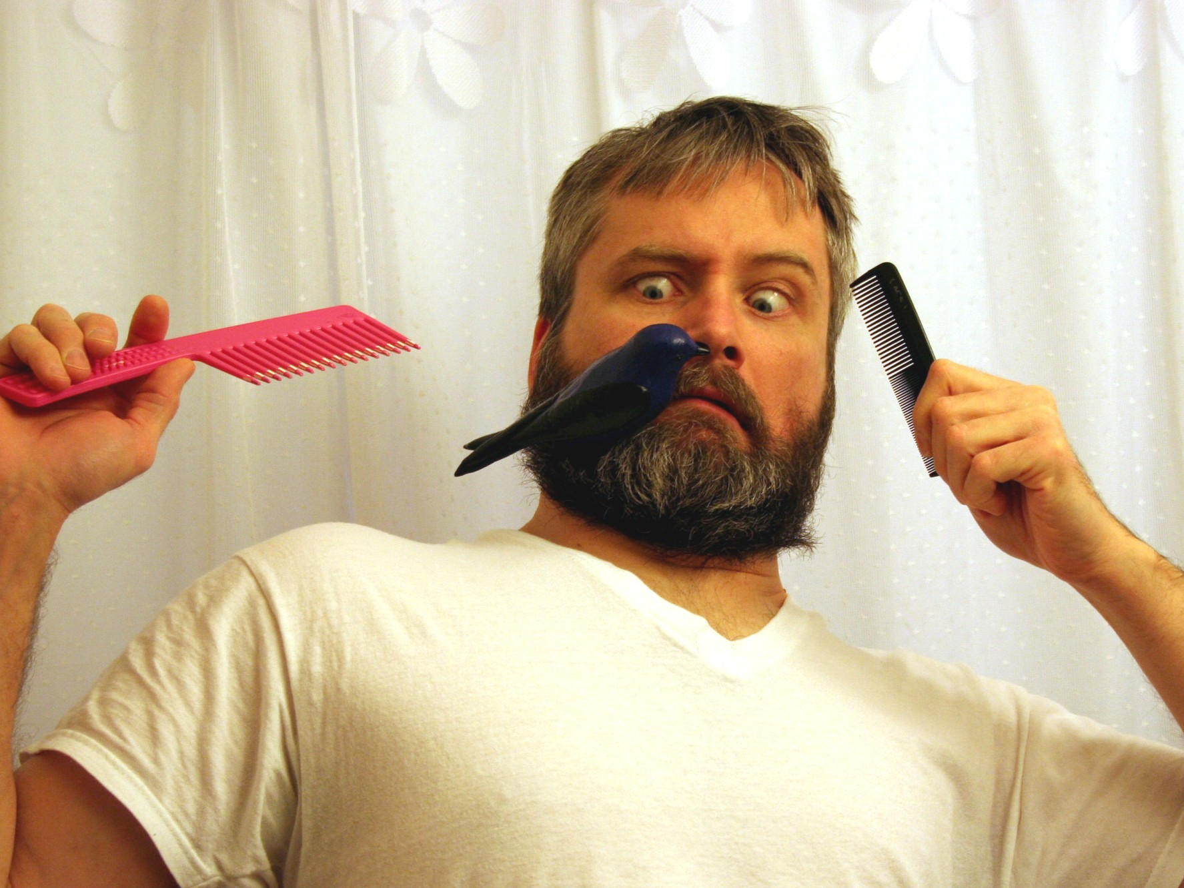
maps
iex(1)> person = %{name: "Bryan", beardy: ▊

Slide 231
maps
iex(1)> person = %{name: "Bryan", beardy: false}▊

Slide 232
maps
iex(1)> person = %{name: "Bryan", beardy: false}
%{beardy: false, name: "Bryan"}
iex(2)> ▊

Slide 233
maps
iex(1)> person = %{name: "Bryan", beardy: false}
%{beardy: false, name: "Bryan"}
iex(2)> person[:name]▊

Slide 234
maps
iex(1)> person = %{name: "Bryan", beardy: false}
%{beardy: false, name: "Bryan"}
iex(2)> person[:name]
"Bryan"
iex(3)> ▊

Slide 235
maps
iex(1)> person = %{name: "Bryan", beardy: false}
%{beardy: false, name: "Bryan"}
iex(2)> person[:name]
"Bryan"
iex(3)> person.name▊

Slide 236
maps
iex(1)> person = %{name: "Bryan", beardy: false}
%{beardy: false, name: "Bryan"}
iex(2)> person[:name]
"Bryan"
iex(3)> person.name
"Bryan"
iex(4)> ▊

Slide 237
maps
iex(1)> person = %{name: "Bryan", beardy: false}
%{beardy: false, name: "Bryan"}
iex(2)> person[:name]
"Bryan"
iex(3)> person.name
"Bryan"
iex(4)> %{person |▊

Slide 238
maps
iex(1)> person = %{name: "Bryan", beardy: false}
%{beardy: false, name: "Bryan"}
iex(2)> person[:name]
"Bryan"
iex(3)> person.name
"Bryan"
iex(4)> %{person | name: "Bryan Hunter"}▊

Slide 239
maps
iex(1)> person = %{name: "Bryan", beardy: false}
%{beardy: false, name: "Bryan"}
iex(2)> person[:name]
"Bryan"
iex(3)> person.name
"Bryan"
iex(4)> %{person | name: "Bryan Hunter"}
%{beardy: false, name: "Bryan Hunter"}
iex(5)> ▊

Slide 240
maps
iex(1)> person = %{name: "Bryan", beardy: false}
%{beardy: false, name: "Bryan"}
iex(2)> person[:name]
"Bryan"
iex(3)> person.name
"Bryan"
iex(4)> %{person | name: "Bryan Hunter"}
%{beardy: false, name: "Bryan Hunter"}
iex(5)> %{person | awake: true}▊

Slide 241
maps
iex(1)> person = %{name: "Bryan", beardy: false}
%{beardy: false, name: "Bryan"}
iex(2)> person[:name]
"Bryan"
iex(3)> person.name
"Bryan"
iex(4)> %{person | name: "Bryan Hunter"}
%{beardy: false, name: "Bryan Hunter"}
iex(5)> %{person | awake: true}
** (KeyError) key :awake not found in: %{beardy: fals
iex(6)> ▊

Slide 242
maps
iex(1)> person = %{name: "Bryan", beardy: false}
%{beardy: false, name: "Bryan"}
iex(2)> person[:name]
"Bryan"
iex(3)> person.name
"Bryan"
iex(4)> %{person | name: "Bryan Hunter"}
%{beardy: false, name: "Bryan Hunter"}
iex(5)> %{person | awake: true}
** (KeyError) key :awake not found in: %{beardy: fals
iex(6)> Map.put(person, :awake, true)▊

Slide 243
maps
iex(1)> person = %{name: "Bryan", beardy: false}
%{beardy: false, name: "Bryan"}
iex(2)> person[:name]
"Bryan"
iex(3)> person.name
"Bryan"
iex(4)> %{person | name: "Bryan Hunter"}
%{beardy: false, name: "Bryan Hunter"}
iex(5)> %{person | awake: true}
** (KeyError) key :awake not found in: %{beardy: fals
iex(6)> Map.put(person, :awake, true)
%{awake: true, beardy: false, name: "Bryan"}
iex(7)> ▊

Slide 244
structs
iex(1)> ▊

Slide 245
structs
iex(1)> defmodule▊

Slide 246
structs
iex(1)> defmodule Person▊

Slide 247
structs
iex(1)> defmodule Person do▊

Slide 248
structs
iex(1)> defmodule Person do
...(1)> ▊

Slide 249
structs
iex(1)> defmodule Person do
...(1)> defstruct▊

Slide 250
structs
iex(1)> defmodule Person do
...(1)> defstruct name: ""▊

Slide 251
structs
iex(1)> defmodule Person do
...(1)> defstruct name: "", beardy: false▊

Slide 252
structs
iex(1)> defmodule Person do
...(1)> defstruct name: "", beardy: false
...(1)> ▊

Slide 253
structs
iex(1)> defmodule Person do
...(1)> defstruct name: "", beardy: false
...(1)> end▊

Slide 254
structs
iex(1)> defmodule Person do
...(1)> defstruct name: "", beardy: false
...(1)> end
{:module, Person, <<70, 79, 82, 49, 0, 0, 5, 0, 66, 69, 65, 77, 69, 120, ...>>,
%Person{beardy: false, name: ""}}
iex(2)> ▊

Slide 255
structs
iex(1)> defmodule Person do
...(1)> defstruct name: "", beardy: false
...(1)> end
{:module, Person, <<70, 79, 82, 49, 0, 0, 5, 0, 66, 69, 65, 77, 69, 120, ...>>,
%Person{beardy: false, name: ""}}
iex(2)> %Person{}▊

Slide 256
structs
iex(1)> defmodule Person do
...(1)> defstruct name: "", beardy: false
...(1)> end
{:module, Person, <<70, 79, 82, 49, 0, 0, 5, 0, 66, 69, 65, 77, 69, 120, ...>>,
%Person{beardy: false, name: ""}}
iex(2)> %Person{}
%Person{beardy: false, name: ""}
iex(3)> ▊

Slide 257
structs
iex(1)> defmodule Person do
...(1)> defstruct name: "", beardy: false
...(1)> end
{:module, Person, <<70, 79, 82, 49, 0, 0, 5, 0, 66, 69, 65, 77, 69, 120, ...>>,
%Person{beardy: false, name: ""}}
iex(2)> %Person{}
%Person{beardy: false, name: ""}
iex(3)> bryan = ▊

Slide 258
structs
iex(1)> defmodule Person do
...(1)> defstruct name: "", beardy: false
...(1)> end
{:module, Person, <<70, 79, 82, 49, 0, 0, 5, 0, 66, 69, 65, 77, 69, 120, ...>>,
%Person{beardy: false, name: ""}}
iex(2)> %Person{}
%Person{beardy: false, name: ""}
iex(3)> bryan = %Person{name: "Bryan"}▊

Slide 259
structs
iex(1)> defmodule Person do
...(1)> defstruct name: "", beardy: false
...(1)> end
{:module, Person, <<70, 79, 82, 49, 0, 0, 5, 0, 66, 69, 65, 77, 69, 120, ...>>,
%Person{beardy: false, name: ""}}
iex(2)> %Person{}
%Person{beardy: false, name: ""}
iex(3)> bryan = %Person{name: "Bryan"}
%Person{beardy: false, name: "Bryan"}
iex(4)> ▊

Slide 260
structs
iex(1)> defmodule Person do
...(1)> defstruct name: "", beardy: false
...(1)> end
{:module, Person, <<70, 79, 82, 49, 0, 0, 5, 0, 66, 69, 65, 77, 69, 120, ...>>,
%Person{beardy: false, name: ""}}
iex(2)> %Person{}
%Person{beardy: false, name: ""}
iex(3)> bryan = %Person{name: "Bryan"}
%Person{beardy: false, name: "Bryan"}
iex(4)> %Person{▊

Slide 261
structs
iex(1)> defmodule Person do
...(1)> defstruct name: "", beardy: false
...(1)> end
{:module, Person, <<70, 79, 82, 49, 0, 0, 5, 0, 66, 69, 65, 77, 69, 120, ...>>,
%Person{beardy: false, name: ""}}
iex(2)> %Person{}
%Person{beardy: false, name: ""}
iex(3)> bryan = %Person{name: "Bryan"}
%Person{beardy: false, name: "Bryan"}
iex(4)> %Person{name: "Bryan"▊

Slide 262
structs
iex(1)> defmodule Person do
...(1)> defstruct name: "", beardy: false
...(1)> end
{:module, Person, <<70, 79, 82, 49, 0, 0, 5, 0, 66, 69, 65, 77, 69, 120, ...>>,
%Person{beardy: false, name: ""}}
iex(2)> %Person{}
%Person{beardy: false, name: ""}
iex(3)> bryan = %Person{name: "Bryan"}
%Person{beardy: false, name: "Bryan"}
iex(4)> %Person{name: "Bryan", bardy: false}▊

Slide 263
structs
iex(1)> defmodule Person do
...(1)> defstruct name: "", beardy: false
...(1)> end
{:module, Person, <<70, 79, 82, 49, 0, 0, 5, 0, 66, 69, 65, 77, 69, 120, ...>>,
%Person{beardy: false, name: ""}}
iex(2)> %Person{}
%Person{beardy: false, name: ""}
iex(3)> bryan = %Person{name: "Bryan"}
%Person{beardy: false, name: "Bryan"}
iex(4)> %Person{name: "Bryan", bardy: false}
** (CompileError) iex:4: unknown key :bardy for struct Person
(elixir) src/elixir_map.erl:185: :elixir_map.assert_struct_keys/5
(elixir) src/elixir_map.erl:62: :elixir_map.translate_struct/4
iex(4)> ▊

Slide 264
Macros
iex(1)> ▊
Notes:
>>> TIME: 40:00 <<<

Slide 265
Macros
iex(1)> result = Fridge.check()▊

Slide 266
Macros
iex(1)> result = Fridge.check() {:ok, [34.9, 35.4, 35.9, 36.1, 35.9]}
iex(2)> ▊

Slide 267
Macros
iex(1)> result = Fridge.check() {:ok, [34.9, 35.4, 35.9, 36.1, 35.9]}
iex(2)> result |> Enum.max()▊

Slide 268
Macros
iex(1)> result = Fridge.check() {:ok, [34.9, 35.4, 35.9, 36.1, 35.9]}
iex(2)> result |> Enum.max()
** (Protocol.UndefinedError) protocol Enumerable not implemented for {:ok, [34.9, 35.4, 35.9, 36.1, 35.9]}
iex(3)> ▊

Slide 269
Macros
iex(1)> result = Fridge.check() {:ok, [34.9, 35.4, 35.9, 36.1, 35.9]}
iex(2)> result |> Enum.max()
** (Protocol.UndefinedError) protocol Enumerable not implemented for {:ok, [34.9, 35.4, 35.9, 36.1, 35.9]}
iex(3)> ▊

Slide 270
Macros
iex(1)> result = Fridge.check() {:ok, [34.9, 35.4, 35.9, 36.1, 35.9]}
iex(2)> result |> Enum.max()
** (Protocol.UndefinedError) protocol Enumerable not implemented for {:ok, [34.9, 35.4, 35.9, 36.1, 35.9]}
iex(3)> {:ok, temps} = result▊

Slide 271
Macros
iex(1)> result = Fridge.check() {:ok, [34.9, 35.4, 35.9, 36.1, 35.9]}
iex(2)> result |> Enum.max()
** (Protocol.UndefinedError) protocol Enumerable not implemented for {:ok, [34.9, 35.4, 35.9, 36.1, 35.9]}
iex(3)> {:ok, temps} = result {:ok, [34.9, 35.4, 35.9, 36.1, 35.9]}
iex(4)> ▊

Slide 272
Macros
iex(1)> result = Fridge.check() {:ok, [34.9, 35.4, 35.9, 36.1, 35.9]}
iex(2)> result |> Enum.max()
** (Protocol.UndefinedError) protocol Enumerable not implemented for {:ok, [34.9, 35.4, 35.9, 36.1, 35.9]}
iex(3)> {:ok, temps} = result {:ok, [34.9, 35.4, 35.9, 36.1, 35.9]}
iex(4)> temps |> Enum.max()▊

Slide 273
Macros
iex(1)> result = Fridge.check() {:ok, [34.9, 35.4, 35.9, 36.1, 35.9]}
iex(2)> result |> Enum.max()
** (Protocol.UndefinedError) protocol Enumerable not implemented for {:ok, [34.9, 35.4, 35.9, 36.1, 35.9]}
iex(3)> {:ok, temps} = result {:ok, [34.9, 35.4, 35.9, 36.1, 35.9]}
iex(4)> temps |> Enum.max()
36.1
iex(5)> ▊

Slide 274
Macros
iex(1)> result = Fridge.check() {:ok, [34.9, 35.4, 35.9, 36.1, 35.9]}
iex(2)> result |> Enum.max()
** (Protocol.UndefinedError) protocol Enumerable not implemented for {:ok, [34.9, 35.4, 35.9, 36.1, 35.9]}
iex(3)> {:ok, temps} = result {:ok, [34.9, 35.4, 35.9, 36.1, 35.9]}
iex(4)> temps |> Enum.max()
36.1
iex(5)> ▊
defmodule Bangpipe do
defmacro left <|> right do
quote do
unquote(left)
|> case do
{:ok, val} -> val
val -> val
end
|> unquote(right)
end
end
end

Slide 275
Macros
iex(1)> result = Fridge.check() {:ok, [34.9, 35.4, 35.9, 36.1, 35.9]}
iex(2)> result |> Enum.max()
** (Protocol.UndefinedError) protocol Enumerable not implemented for {:ok, [34.9, 35.4, 35.9, 36.1, 35.9]}
iex(3)> {:ok, temps} = result {:ok, [34.9, 35.4, 35.9, 36.1, 35.9]}
iex(4)> temps |> Enum.max()
36.1
iex(5)> import Bangpipe▊
defmodule Bangpipe do
defmacro left <|> right do
quote do
unquote(left)
|> case do
{:ok, val} -> val
val -> val
end
|> unquote(right)
end
end
end

Slide 276
Macros
iex(1)> result = Fridge.check() {:ok, [34.9, 35.4, 35.9, 36.1, 35.9]}
iex(2)> result |> Enum.max()
** (Protocol.UndefinedError) protocol Enumerable not implemented for {:ok, [34.9, 35.4, 35.9, 36.1, 35.9]}
iex(3)> {:ok, temps} = result {:ok, [34.9, 35.4, 35.9, 36.1, 35.9]}
iex(4)> temps |> Enum.max()
36.1
iex(5)> import Bangpipe
Bangpipe
iex(6)> ▊
defmodule Bangpipe do
defmacro left <|> right do
quote do
unquote(left)
|> case do
{:ok, val} -> val
val -> val
end
|> unquote(right)
end
end
end

Slide 277
Macros
iex(1)> result = Fridge.check() {:ok, [34.9, 35.4, 35.9, 36.1, 35.9]}
iex(2)> result |> Enum.max()
** (Protocol.UndefinedError) protocol Enumerable not implemented for {:ok, [34.9, 35.4, 35.9, 36.1, 35.9]}
iex(3)> {:ok, temps} = result {:ok, [34.9, 35.4, 35.9, 36.1, 35.9]}
iex(4)> temps |> Enum.max()
36.1
iex(5)> import Bangpipe
Bangpipe
iex(6)> Fridge.check() <|> Enum.max()▊
defmodule Bangpipe do
defmacro left <|> right do
quote do
unquote(left)
|> case do
{:ok, val} -> val
val -> val
end
|> unquote(right)
end
end
end
Fridge.check()
Enum.max()

Slide 278
Macros
iex(1)> result = Fridge.check() {:ok, [34.9, 35.4, 35.9, 36.1, 35.9]}
iex(2)> result |> Enum.max()
** (Protocol.UndefinedError) protocol Enumerable not implemented for {:ok, [34.9, 35.4, 35.9, 36.1, 35.9]}
iex(3)> {:ok, temps} = result {:ok, [34.9, 35.4, 35.9, 36.1, 35.9]}
iex(4)> temps |> Enum.max()
36.1
iex(5)> import Bangpipe
Bangpipe
iex(6)> Fridge.check() <|> Enum.max() 36.1 iex(7)> ▊
defmodule Bangpipe do
defmacro left <|> right do
quote do
unquote(left)
|> case do
{:ok, val} -> val
val -> val
end
|> unquote(right)
end
end
end
Fridge.check()
Enum.max()

Slide 279
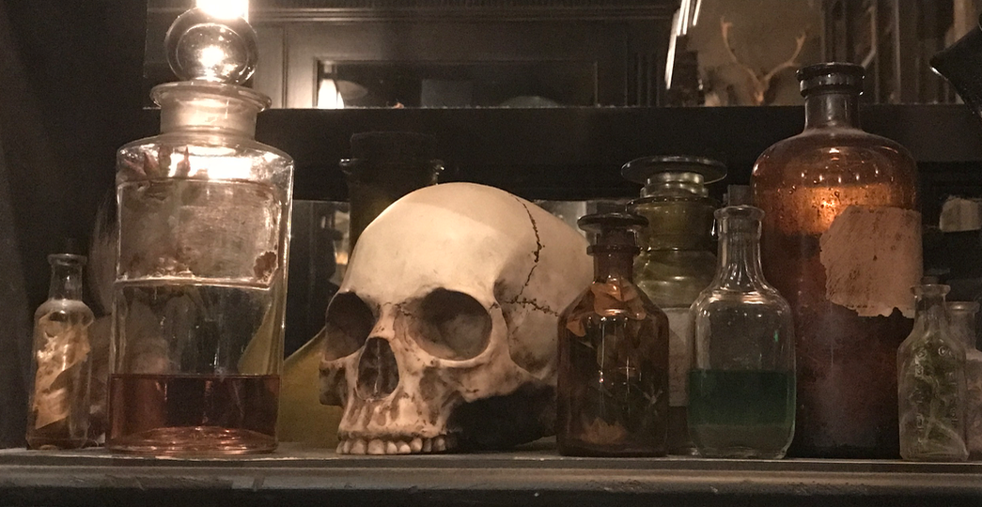
Macros
iex(1)> result = Fridge.check() {:ok, [34.9, 35.4, 35.9, 36.1, 35.9]}
iex(2)> result |> Enum.max()
** (Protocol.UndefinedError) protocol Enumerable not implemented for {:ok, [34.9, 35.4, 35.9, 36.1, 35.9]}
iex(3)> {:ok, temps} = result {:ok, [34.9, 35.4, 35.9, 36.1, 35.9]}
iex(4)> temps |> Enum.max()
36.1
iex(5)> import Bangpipe
Bangpipe
iex(6)> result <|> Enum.max() 36.1 iex(7)> ▊

Slide 280
Macros
So… when should I write macros?
When you are José
When José personally asks you to write a macro
When not having the macro makes you and your team sadder than having the macro
Notes:
https://commons.wikimedia.org/wiki/File:Hermey_the_elf_and_Rudolph.jpg

Slide 281
Versatile

Slide 282
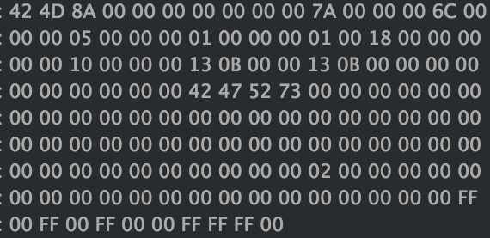
Bit Syntax
bit syntax
iex(1)> ▊
krgbw.bmp, 24-bit color, 5 pixels x 1 pixel

Slide 283
bit syntax
iex(1)> {:ok, bindata} = ▊

Slide 284
bit syntax
iex(1)> {:ok, bindata} = File.read("krgbw.bmp")▊

Slide 285
bit syntax
iex(1)> {:ok, bindata} = File.read("krgbw.bmp") {:ok, <<66, 77, 138, 0, 0, 0, 0, 0, 0, 0, 122, 0, 0, 0, 108, 0, 0, 0, 5, 0, 0, 0, 1, 0, 0, 0, 1, 0, 24, 0, 0, 0, 0, 0, 16, 0, 0, 0, 19, 11, 0, 0, 19, 11, 0, ...>>} iex(2)> ▊

Slide 286
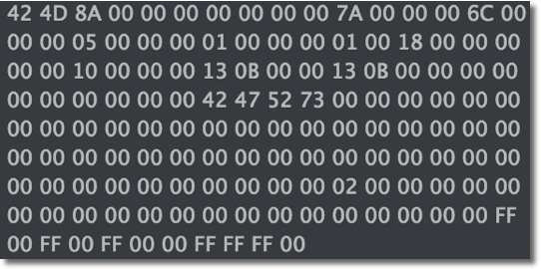
bit syntax
iex(1)> {:ok, bindata} = File.read("krgbw.bmp") {:ok, <<66, 77, 138, 0, 0, 0, 0, 0, 0, 0, 122, 0, 0, 0, 108, 0, 0, 0, 5, 0, 0, 0, 1, 0, 0, 0, 1, 0, 24, 0, 0, 0, 0, 0, 16, 0, 0, 0, 19, 11, 0, 0, 19, 11, 0, ...>>} iex(2)> ▊

Slide 287
bit syntax
iex(1)> {:ok, bindata} = File.read("krgbw.bmp") {:ok, <<66, 77, 138, 0, 0, 0, 0, 0, 0, 0, 122, 0, 0, 0, 108, 0, 0, 0, 5, 0, 0, 0, 1, 0, 0, 0, 1, 0, 24, 0, 0, 0, 0, 0, 16, 0, 0, 0, 19, 11, 0, 0, 19, 11, 0, ...>>} iex(2)> <<"BM", _::size(64), offset_to_pixels::size(32)-little,▊

Slide 288
bit syntax
iex(1)> {:ok, bindata} = File.read("krgbw.bmp") {:ok, <<66, 77, 138, 0, 0, 0, 0, 0, 0, 0, 122, 0, 0, 0, 108, 0, 0, 0, 5, 0, 0, 0, 1, 0, 0, 0, 1, 0, 24, 0, 0, 0, 0, 0, 16, 0, 0, 0, 19, 11, 0, 0, 19, 11, 0, ...>>} iex(2)> <<"BM", _::size(64), offset_to_pixels::size(32)-little, ...(2)> _::size(32), width::size(32)-little, height::size(32)-little,▊

Slide 289
bit syntax
iex(1)> {:ok, bindata} = File.read("krgbw.bmp") {:ok, <<66, 77, 138, 0, 0, 0, 0, 0, 0, 0, 122, 0, 0, 0, 108, 0, 0, 0, 5, 0, 0, 0, 1, 0, 0, 0, 1, 0, 24, 0, 0, 0, 0, 0, 16, 0, 0, 0, 19, 11, 0, 0, 19, 11, 0, ...>>} iex(2)> <<"BM", _::size(64), offset_to_pixels::size(32)-little, ...(2)> _::size(32), width::size(32)-little, height::size(32)-little, ...(2)> _::size(16), 24::size(16)-little, _rest::binary>> = bindata▊

Slide 290
bit syntax
iex(1)> {:ok, bindata} = File.read("krgbw.bmp") {:ok, <<66, 77, 138, 0, 0, 0, 0, 0, 0, 0, 122, 0, 0, 0, 108, 0, 0, 0, 5, 0, 0, 0, 1, 0, 0, 0, 1, 0, 24, 0, 0, 0, 0, 0, 16, 0, 0, 0, 19, 11, 0, 0, 19, 11, 0, ...>>} iex(2)> <<"BM", _::size(64), offset_to_pixels::size(32)-little, ...(2)> _::size(32), width::size(32)-little, height::size(32)-little, ...(2)> _::size(16), 24::size(16)-little, _rest::binary>> = bindata <<66, 77, 138, 0, 0, 0, 0, 0, 0, 0, 122, 0, 0, 0, 108, 0, 0, 0, 5, 0, 0, 0, 1, 0, 0, 0, 1, 0, 24, 0, 0, 0, 0, 0, 16, 0, 0, 0, 19, 11, 0, 0, 19, 11, 0, 0, 0, ...>> iex(3)> ▊
"BM" == [66,77] 0x42 == 66 0x4D == 77

Slide 291
bit syntax
iex(1)> {:ok, bindata} = File.read("krgbw.bmp") {:ok, <<66, 77, 138, 0, 0, 0, 0, 0, 0, 0, 122, 0, 0, 0, 108, 0, 0, 0, 5, 0, 0, 0, 1, 0, 0, 0, 1, 0, 24, 0, 0, 0, 0, 0, 16, 0, 0, 0, 19, 11, 0, 0, 19, 11, 0, ...>>} iex(2)> <<"BM", _::size(64), offset_to_pixels::size(32)-little, ...(2)> _::size(32), width::size(32)-little, height::size(32)-little, ...(2)> _::size(16), 24::size(16)-little, _rest::binary>> = bindata <<66, 77, 138, 0, 0, 0, 0, 0, 0, 0, 122, 0, 0, 0, 108, 0, 0, 0, 5, 0, 0, 0, 1, 0, 0, 0, 1, 0, 24, 0, 0, 0, 0, 0, 16, 0, 0, 0, 19, 11, 0, 0, 19, 11, 0, 0, 0, ...>> iex(3)> ▊

Slide 292
bit syntax
iex(1)> {:ok, bindata} = File.read("krgbw.bmp") {:ok, <<66, 77, 138, 0, 0, 0, 0, 0, 0, 0, 122, 0, 0, 0, 108, 0, 0, 0, 5, 0, 0, 0, 1, 0, 0, 0, 1, 0, 24, 0, 0, 0, 0, 0, 16, 0, 0, 0, 19, 11, 0, 0, 19, 11, 0, ...>>} iex(2)> <<"BM", _::size(64), offset_to_pixels::size(32)-little, ...(2)> _::size(32), width::size(32)-little, height::size(32)-little, ...(2)> _::size(16), 24::size(16)-little, _rest::binary>> = bindata <<66, 77, 138, 0, 0, 0, 0, 0, 0, 0, 122, 0, 0, 0, 108, 0, 0, 0, 5, 0, 0, 0, 1, 0, 0, 0, 1, 0, 24, 0, 0, 0, 0, 0, 16, 0, 0, 0, 19, 11, 0, 0, 19, 11, 0, 0, 0, ...>> iex(3)> ▊

Slide 293
bit syntax
iex(1)> {:ok, bindata} = File.read("krgbw.bmp") {:ok, <<66, 77, 138, 0, 0, 0, 0, 0, 0, 0, 122, 0, 0, 0, 108, 0, 0, 0, 5, 0, 0, 0, 1, 0, 0, 0, 1, 0, 24, 0, 0, 0, 0, 0, 16, 0, 0, 0, 19, 11, 0, 0, 19, 11, 0, ...>>} iex(2)> <<"BM", _::size(64), offset_to_pixels::size(32)-little, ...(2)> _::size(32), width::size(32)-little, height::size(32)-little, ...(2)> _::size(16), 24::size(16)-little, _rest::binary>> = bindata <<66, 77, 138, 0, 0, 0, 0, 0, 0, 0, 122, 0, 0, 0, 108, 0, 0, 0, 5, 0, 0, 0, 1, 0, 0, 0, 1, 0, 24, 0, 0, 0, 0, 0, 16, 0, 0, 0, 19, 11, 0, 0, 19, 11, 0, 0, 0, ...>> iex(3)> ▊

Slide 294
bit syntax
iex(1)> {:ok, bindata} = File.read("krgbw.bmp") {:ok, <<66, 77, 138, 0, 0, 0, 0, 0, 0, 0, 122, 0, 0, 0, 108, 0, 0, 0, 5, 0, 0, 0, 1, 0, 0, 0, 1, 0, 24, 0, 0, 0, 0, 0, 16, 0, 0, 0, 19, 11, 0, 0, 19, 11, 0, ...>>} iex(2)> <<"BM", _::size(64), offset_to_pixels::size(32)-little, ...(2)> _::size(32), width::size(32)-little, height::size(32)-little, ...(2)> _::size(16), 24::size(16)-little, _rest::binary>> = bindata <<66, 77, 138, 0, 0, 0, 0, 0, 0, 0, 122, 0, 0, 0, 108, 0, 0, 0, 5, 0, 0, 0, 1, 0, 0, 0, 1, 0, 24, 0, 0, 0, 0, 0, 16, 0, 0, 0, 19, 11, 0, 0, 19, 11, 0, 0, 0, ...>> iex(3)> ▊

Slide 295
bit syntax
iex(1)> {:ok, bindata} = File.read("krgbw.bmp") {:ok, <<66, 77, 138, 0, 0, 0, 0, 0, 0, 0, 122, 0, 0, 0, 108, 0, 0, 0, 5, 0, 0, 0, 1, 0, 0, 0, 1, 0, 24, 0, 0, 0, 0, 0, 16, 0, 0, 0, 19, 11, 0, 0, 19, 11, 0, ...>>} iex(2)> <<"BM", _::size(64), offset_to_pixels::size(32)-little, ...(2)> _::size(32), width::size(32)-little, height::size(32)-little, ...(2)> _::size(16), 24::size(16)-little, _rest::binary>> = bindata <<66, 77, 138, 0, 0, 0, 0, 0, 0, 0, 122, 0, 0, 0, 108, 0, 0, 0, 5, 0, 0, 0, 1, 0, 0, 0, 1, 0, 24, 0, 0, 0, 0, 0, 16, 0, 0, 0, 19, 11, 0, 0, 19, 11, 0, 0, 0, ...>> iex(3)> ▊

Slide 296
bit syntax
iex(1)> {:ok, bindata} = File.read("krgbw.bmp") {:ok, <<66, 77, 138, 0, 0, 0, 0, 0, 0, 0, 122, 0, 0, 0, 108, 0, 0, 0, 5, 0, 0, 0, 1, 0, 0, 0, 1, 0, 24, 0, 0, 0, 0, 0, 16, 0, 0, 0, 19, 11, 0, 0, 19, 11, 0, ...>>} iex(2)> <<"BM", _::size(64), offset_to_pixels::size(32)-little, ...(2)> _::size(32), width::size(32)-little, height::size(32)-little, ...(2)> _::size(16), 24::size(16)-little, _rest::binary>> = bindata <<66, 77, 138, 0, 0, 0, 0, 0, 0, 0, 122, 0, 0, 0, 108, 0, 0, 0, 5, 0, 0, 0, 1, 0, 0, 0, 1, 0, 24, 0, 0, 0, 0, 0, 16, 0, 0, 0, 19, 11, 0, 0, 19, 11, 0, 0, 0, ...>> iex(3)> ▊

Slide 297
bit syntax
iex(1)> {:ok, bindata} = File.read("krgbw.bmp") {:ok, <<66, 77, 138, 0, 0, 0, 0, 0, 0, 0, 122, 0, 0, 0, 108, 0, 0, 0, 5, 0, 0, 0, 1, 0, 0, 0, 1, 0, 24, 0, 0, 0, 0, 0, 16, 0, 0, 0, 19, 11, 0, 0, 19, 11, 0, ...>>} iex(2)> <<"BM", _::size(64), offset_to_pixels::size(32)-little, ...(2)> _::size(32), width::size(32)-little, height::size(32)-little, ...(2)> _::size(16), 24::size(16)-little, _rest::binary>> = bindata <<66, 77, 138, 0, 0, 0, 0, 0, 0, 0, 122, 0, 0, 0, 108, 0, 0, 0, 5, 0, 0, 0, 1, 0, 0, 0, 1, 0, 24, 0, 0, 0, 0, 0, 16, 0, 0, 0, 19, 11, 0, 0, 19, 11, 0, 0, 0, ...>> iex(3)> ▊

Slide 298
bit syntax
iex(1)> {:ok, bindata} = File.read("krgbw.bmp") {:ok, <<66, 77, 138, 0, 0, 0, 0, 0, 0, 0, 122, 0, 0, 0, 108, 0, 0, 0, 5, 0, 0, 0, 1, 0, 0, 0, 1, 0, 24, 0, 0, 0, 0, 0, 16, 0, 0, 0, 19, 11, 0, 0, 19, 11, 0, ...>>} iex(2)> <<"BM", _::size(64), offset_to_pixels::size(32)-little, ...(2)> _::size(32), width::size(32)-little, height::size(32)-little, ...(2)> _::size(16), 24::size(16)-little, _rest::binary>> = bindata <<66, 77, 138, 0, 0, 0, 0, 0, 0, 0, 122, 0, 0, 0, 108, 0, 0, 0, 5, 0, 0, 0, 1, 0, 0, 0, 1, 0, 24, 0, 0, 0, 0, 0, 16, 0, 0, 0, 19, 11, 0, 0, 19, 11, 0, 0, 0, ...>> iex(3)> ▊

Slide 299
bit syntax
iex(1)> {:ok, bindata} = File.read("krgbw.bmp") {:ok, <<66, 77, 138, 0, 0, 0, 0, 0, 0, 0, 122, 0, 0, 0, 108, 0, 0, 0, 5, 0, 0, 0, 1, 0, 0, 0, 1, 0, 24, 0, 0, 0, 0, 0, 16, 0, 0, 0, 19, 11, 0, 0, 19, 11, 0, ...>>} iex(2)> <<"BM", _::size(64), offset_to_pixels::size(32)-little, ...(2)> _::size(32), width::size(32)-little, height::size(32)-little, ...(2)> _::size(16), 24::size(16)-little, _rest::binary>> = bindata <<66, 77, 138, 0, 0, 0, 0, 0, 0, 0, 122, 0, 0, 0, 108, 0, 0, 0, 5, 0, 0, 0, 1, 0, 0, 0, 1, 0, 24, 0, 0, 0, 0, 0, 16, 0, 0, 0, 19, 11, 0, 0, 19, 11, 0, 0, 0, ...>> iex(3)> ▊

Slide 300
bit syntax
iex(1)> {:ok, bindata} = File.read("krgbw.bmp") {:ok, <<66, 77, 138, 0, 0, 0, 0, 0, 0, 0, 122, 0, 0, 0, 108, 0, 0, 0, 5, 0, 0, 0, 1, 0, 0, 0, 1, 0, 24, 0, 0, 0, 0, 0, 16, 0, 0, 0, 19, 11, 0, 0, 19, 11, 0, ...>>} iex(2)> <<"BM", _::size(64), offset_to_pixels::size(32)-little, ...(2)> _::size(32), width::size(32)-little, height::size(32)-little, ...(2)> _::size(16), 24::size(16)-little, _rest::binary>> = bindata <<66, 77, 138, 0, 0, 0, 0, 0, 0, 0, 122, 0, 0, 0, 108, 0, 0, 0, 5, 0, 0, 0, 1, 0, 0, 0, 1, 0, 24, 0, 0, 0, 0, 0, 16, 0, 0, 0, 19, 11, 0, 0, 19, 11, 0, 0, 0, ...>> iex(3)> ▊

Slide 301
bit syntax
iex(1)> {:ok, bindata} = File.read("krgbw.bmp") {:ok, <<66, 77, 138, 0, 0, 0, 0, 0, 0, 0, 122, 0, 0, 0, 108, 0, 0, 0, 5, 0, 0, 0, 1, 0, 0, 0, 1, 0, 24, 0, 0, 0, 0, 0, 16, 0, 0, 0, 19, 11, 0, 0, 19, 11, 0, ...>>} iex(2)> <<"BM", _::size(64), offset_to_pixels::size(32)-little, ...(2)> _::size(32), width::size(32)-little, height::size(32)-little, ...(2)> _::size(16), 24::size(16)-little, _rest::binary>> = bindata <<66, 77, 138, 0, 0, 0, 0, 0, 0, 0, 122, 0, 0, 0, 108, 0, 0, 0, 5, 0, 0, 0, 1, 0, 0, 0, 1, 0, 24, 0, 0, 0, 0, 0, 16, 0, 0, 0, 19, 11, 0, 0, 19, 11, 0, 0, 0, ...>> iex(3)> IO.puts "Offset:#{offset_to_pixels} Width:#{width} Height:#{height}"▊

Slide 302
bit syntax
iex(1)> {:ok, bindata} = File.read("krgbw.bmp") {:ok, <<66, 77, 138, 0, 0, 0, 0, 0, 0, 0, 122, 0, 0, 0, 108, 0, 0, 0, 5, 0, 0, 0, 1, 0, 0, 0, 1, 0, 24, 0, 0, 0, 0, 0, 16, 0, 0, 0, 19, 11, 0, 0, 19, 11, 0, ...>>} iex(2)> <<"BM", _::size(64), offset_to_pixels::size(32)-little, ...(2)> _::size(32), width::size(32)-little, height::size(32)-little, ...(2)> _::size(16), 24::size(16)-little, _rest::binary>> = bindata <<66, 77, 138, 0, 0, 0, 0, 0, 0, 0, 122, 0, 0, 0, 108, 0, 0, 0, 5, 0, 0, 0, 1, 0, 0, 0, 1, 0, 24, 0, 0, 0, 0, 0, 16, 0, 0, 0, 19, 11, 0, 0, 19, 11, 0, 0, 0, ...>> iex(3)> IO.puts "Offset:#{offset_to_pixels} Width:#{width} Height:#{height}" Offset:122 Width:5 Height:1 :ok iex(4)> ▊

Slide 303
bit syntax
iex(1)> {:ok, bindata} = File.read("krgbw.bmp") {:ok, <<66, 77, 138, 0, 0, 0, 0, 0, 0, 0, 122, 0, 0, 0, 108, 0, 0, 0, 5, 0, 0, 0, 1, 0, 0, 0, 1, 0, 24, 0, 0, 0, 0, 0, 16, 0, 0, 0, 19, 11, 0, 0, 19, 11, 0, ...>>} iex(2)> <<"BM", _::size(64), offset_to_pixels::size(32)-little, ...(2)> _::size(32), width::size(32)-little, height::size(32)-little, ...(2)> _::size(16), 24::size(16)-little, _rest::binary>> = bindata <<66, 77, 138, 0, 0, 0, 0, 0, 0, 0, 122, 0, 0, 0, 108, 0, 0, 0, 5, 0, 0, 0, 1, 0, 0, 0, 1, 0, 24, 0, 0, 0, 0, 0, 16, 0, 0, 0, 19, 11, 0, 0, 19, 11, 0, 0, 0, ...>> iex(3)> IO.puts "Offset:#{offset_to_pixels} Width:#{width} Height:#{height}" Offset:122 Width:5 Height:1 :ok iex(4)> <<_::size(offset_to_pixels)-bytes, pixels::binary>> = bindata▊

Slide 304
bit syntax
iex(1)> {:ok, bindata} = File.read("krgbw.bmp") {:ok, <<66, 77, 138, 0, 0, 0, 0, 0, 0, 0, 122, 0, 0, 0, 108, 0, 0, 0, 5, 0, 0, 0, 1, 0, 0, 0, 1, 0, 24, 0, 0, 0, 0, 0, 16, 0, 0, 0, 19, 11, 0, 0, 19, 11, 0, ...>>} iex(2)> <<"BM", _::size(64), offset_to_pixels::size(32)-little, ...(2)> _::size(32), width::size(32)-little, height::size(32)-little, ...(2)> _::size(16), 24::size(16)-little, _rest::binary>> = bindata <<66, 77, 138, 0, 0, 0, 0, 0, 0, 0, 122, 0, 0, 0, 108, 0, 0, 0, 5, 0, 0, 0, 1, 0, 0, 0, 1, 0, 24, 0, 0, 0, 0, 0, 16, 0, 0, 0, 19, 11, 0, 0, 19, 11, 0, 0, 0, ...>> iex(3)> IO.puts "Offset:#{offset_to_pixels} Width:#{width} Height:#{height}" Offset:122 Width:5 Height:1 :ok iex(4)> <<_::size(offset_to_pixels)-bytes, pixels::binary>> = bindata <<66, 77, 138, 0, 0, 0, 0, 0, 0, 0, 122, 0, 0, 0, 108, 0, 0, 0, 5, 0, 0, 0, 1, 0, 0, 0, 1, 0, 24, 0, 0, 0, 0, 0, 16, 0, 0, 0, 19, 11, 0, 0, 19, 11, 0, 0, 0, ...>> iex(5)> ▊

Slide 305
bit syntax
iex(1)> {:ok, bindata} = File.read("krgbw.bmp") {:ok, <<66, 77, 138, 0, 0, 0, 0, 0, 0, 0, 122, 0, 0, 0, 108, 0, 0, 0, 5, 0, 0, 0, 1, 0, 0, 0, 1, 0, 24, 0, 0, 0, 0, 0, 16, 0, 0, 0, 19, 11, 0, 0, 19, 11, 0, ...>>} iex(2)> <<"BM", _::size(64), offset_to_pixels::size(32)-little, ...(2)> _::size(32), width::size(32)-little, height::size(32)-little, ...(2)> _::size(16), 24::size(16)-little, _rest::binary>> = bindata <<66, 77, 138, 0, 0, 0, 0, 0, 0, 0, 122, 0, 0, 0, 108, 0, 0, 0, 5, 0, 0, 0, 1, 0, 0, 0, 1, 0, 24, 0, 0, 0, 0, 0, 16, 0, 0, 0, 19, 11, 0, 0, 19, 11, 0, 0, 0, ...>> iex(3)> IO.puts "Offset:#{offset_to_pixels} Width:#{width} Height:#{height}" Offset:122 Width:5 Height:1 :ok iex(4)> <<_::size(offset_to_pixels)-bytes, pixels::binary>> = bindata <<66, 77, 138, 0, 0, 0, 0, 0, 0, 0, 122, 0, 0, 0, 108, 0, 0, 0, 5, 0, 0, 0, 1, 0, 0, 0, 1, 0, 24, 0, 0, 0, 0, 0, 16, 0, 0, 0, 19, 11, 0, 0, 19, 11, 0, 0, 0, ...>> iex(5)> for <<b::size(8), g::size(8), r::size(8) <- pixels >>, do: {r,g,b}▊

Slide 306
bit syntax
iex(1)> {:ok, bindata} = File.read("krgbw.bmp") {:ok, <<66, 77, 138, 0, 0, 0, 0, 0, 0, 0, 122, 0, 0, 0, 108, 0, 0, 0, 5, 0, 0, 0, 1, 0, 0, 0, 1, 0, 24, 0, 0, 0, 0, 0, 16, 0, 0, 0, 19, 11, 0, 0, 19, 11, 0, ...>>} iex(2)> <<"BM", _::size(64), offset_to_pixels::size(32)-little, ...(2)> _::size(32), width::size(32)-little, height::size(32)-little, ...(2)> _::size(16), 24::size(16)-little, _rest::binary>> = bindata <<66, 77, 138, 0, 0, 0, 0, 0, 0, 0, 122, 0, 0, 0, 108, 0, 0, 0, 5, 0, 0, 0, 1, 0, 0, 0, 1, 0, 24, 0, 0, 0, 0, 0, 16, 0, 0, 0, 19, 11, 0, 0, 19, 11, 0, 0, 0, ...>> iex(3)> IO.puts "Offset:#{offset_to_pixels} Width:#{width} Height:#{height}" Offset:122 Width:5 Height:1 :ok iex(4)> <<_::size(offset_to_pixels)-bytes, pixels::binary>> = bindata <<66, 77, 138, 0, 0, 0, 0, 0, 0, 0, 122, 0, 0, 0, 108, 0, 0, 0, 5, 0, 0, 0, 1, 0, 0, 0, 1, 0, 24, 0, 0, 0, 0, 0, 16, 0, 0, 0, 19, 11, 0, 0, 19, 11, 0, 0, 0, ...>> iex(5)> for <<b::size(8), g::size(8), r::size(8) <- pixels >>, do: {r,g,b} [{0, 0, 0}, {255, 0, 0}, {0, 255, 0}, {0, 0, 255}, {255, 255, 255}] iex(6)> ▊

Slide 307
bit syntax
iex(1)> {:ok, bindata} = File.read("krgbw.bmp") {:ok, <<66, 77, 138, 0, 0, 0, 0, 0, 0, 0, 122, 0, 0, 0, 108, 0, 0, 0, 5, 0, 0, 0, 1, 0, 0, 0, 1, 0, 24, 0, 0, 0, 0, 0, 16, 0, 0, 0, 19, 11, 0, 0, 19, 11, 0, ...>>} iex(2)> <<"BM", _::size(64), offset_to_pixels::size(32)-little, ...(2)> _::size(32), width::size(32)-little, height::size(32)-little, ...(2)> _::size(16), 24::size(16)-little, _rest::binary>> = bindata <<66, 77, 138, 0, 0, 0, 0, 0, 0, 0, 122, 0, 0, 0, 108, 0, 0, 0, 5, 0, 0, 0, 1, 0, 0, 0, 1, 0, 24, 0, 0, 0, 0, 0, 16, 0, 0, 0, 19, 11, 0, 0, 19, 11, 0, 0, 0, ...>> iex(3)> IO.puts "Offset:#{offset_to_pixels} Width:#{width} Height:#{height}" Offset:122 Width:5 Height:1 :ok iex(4)> <<_::size(offset_to_pixels)-bytes, pixels::binary>> = bindata <<66, 77, 138, 0, 0, 0, 0, 0, 0, 0, 122, 0, 0, 0, 108, 0, 0, 0, 5, 0, 0, 0, 1, 0, 0, 0, 1, 0, 24, 0, 0, 0, 0, 0, 16, 0, 0, 0, 19, 11, 0, 0, 19, 11, 0, 0, 0, ...>> iex(5)> for <<b::size(8), g::size(8), r::size(8) <- pixels >>, do: {r,g,b} [{0, 0, 0}, {255, 0, 0}, {0, 255, 0}, {0, 0, 255}, {255, 255, 255}] iex(6)> ▊

Slide 308
Time for a demo?
$ ▊
nodes
$ ▊
$ ▊
Notes:
15 minutes left?

Slide 309
Was that a bellyful?

Slide 310
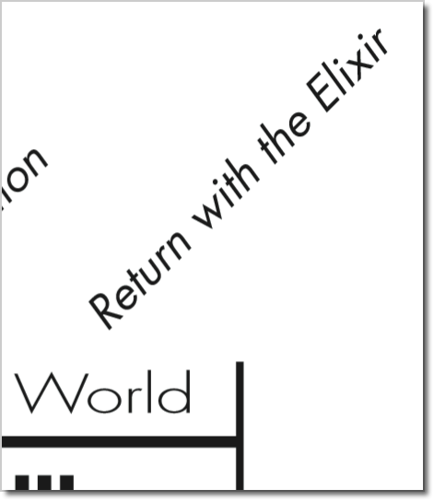

Slide 311




History of Elixir
Notes:
WikiMedia commons
http://commons.wikimedia.org/wiki/File:%C3%89lixir_Combier.jpg

Slide 312
Thanks! Questions?
https://github.com/bryanhunter/elixir-by-the-bellyful Keep in touch
@bryan_hunter

